Slide 1
Notes:
Welcome to the Personal Finance Workshop created by the Farm Credit Associations of NC. We hope this presentation will help you with planning your finances for today and preparing for tomorrow.

Slide 2
PERSONAL SAFETY
BE PROTECTIVE OVER YOUR FINANCES
Notes:
One of the most important topics in finance is personal safety. Be protective over your finances! Lets take a look at how to better protect your information on the internet and at how lenders protect your information.

Slide 3
THE FIRST STEPS TO KEEPING YOUR INFORMATION SAFE
Understand what kind of websites to stay away from
Complete updates regularly
Turn automatic updates on
Notes:
Technology is an amazing innovation that has eased many complicated processes. From being able to shop online from the comfort of your couch to banking right at your fingertips. Technology has many positives and has helped many people stay connected across the globe but with these positives comes some negatives. There are bad people out there looking to steal your personal information which is why it is important to be able to identify secure websites and how to better protect yourself from your information falling into the wrong hands.
Regularly updating your computer is crucial in helping to fight off viruses and other malware that may damage your computer. Windows regularly updates when you restart your computer so be sure to restart your computer at least once a week so your computer can be prepared to fight off hackers. The updates can be found in the control panel under system. To prevent from you having to manually update it you can set it to auto updates so your computer stays up to date.

Slide 4
VIRUS SOFTWARE
Fights malicious software
Blocks suspicious activity
Confirms the safety of your computer and software
Use Pop-up blocker
Notes:
In 2019 Malware attacks were ranked as the 4th ranking mobile security concern. One popular form of malware are the pop-ups that uses scare tactics saying your computer is infected when in reality it is not. Viruses are a type of software scammers use that can slow your computer and also result in data loss. More malicious viruses are capable of stealing your private information. Just as windows needs to be updated regularly so does your virus protection software. Virus protection software acts as a wall of defense for your computer. It is able to track malicious software and flag suspicious behavior. There are numerous antivirus software but it is up to you to decide which one best fits your needs. In order for the antivirus software to work properly it is important to keep it up to date and renewed. Another way to better protect your computer from viruses is to disable pop-ups. You can disable pop-ups easily through settings in your web browser. Blocking pop-ups lowers the risk of you accidentally clicking an ad that may make your computer more susceptible to a virus.

Slide 5
SIGNS OF A SECURE WEBSITE
Privacy Policy
CLEAR privacy policy
Contact Info
Easy to navigate
Password Management
DO NOT use the same password
Required
Vague policy
Social media listed
Trustworthy
1password software easily manages all passwords
Notes:
Many tasks can now be completed online through various websites. These websites sometimes require confidential information that in the hands of the wrong person, could do some damage. This is why it is important to understand what a safe website looks like. The 1st sign of a safe website is the presence of HTTPS. HTTPS in a URL eliminates the possibility of someone else capturing the data packets in transit. A green padlock can be seen before the URL making it visible that the site is safe.
When on a website they should provide a privacy policy that CLEARLY states how your data is collected and stored. A vague policy is as good as no policy so be sure that they clearly state their intent with the data as it is required by data privacy laws. A clearly stated privacy policy lets you know that the owner understands the laws and is taking to necessary steps to ensure your data does not end up in the wrong hands.
Contact information does not mean a site is necessarily safe but it seems more trustworthy. Typically safe websites have an easy to find contact page or contact information, Generally they also list social media accounts and return policies. Though this does not mean the site is necessarily secure it means you at least have someone to contact if something goes wrong.
Almost any account created online requires a password of some sort which can become very elaborate. Having numerous accounts it can become difficult to manage all the passwords. It may seem very tempting but using the same password across all platforms is strongly discouraged as hackers can have access to everything if they get their hands on that password. There is a software program that can be used to store your passwords in your own personal vault. You’ll only need to remember the password for the vault then there you can access your passwords for other sites.

Slide 6
BE WEARY OF SUSPICIOUS EMAILS
Phishing
DO NOT GIVE OUT YOUR PASSWORD
DO NOT click on links through emails that request payment information or password disclosure
Notes:
Scammers sometime use emails to try and get your personal information, this is called phishing. These emails may look like they’re from a bank or company that you know. These emails will usually say that they’ve noticed some suspicious activity, offer free stuff and request your password. DO NOT GIVE OUT YOUR PASSWORD! Avoid clicking on links through emails that request personal information. If in doubt of an email, contact the company directly. In order to protect yourself from these emails it is important to use security software on both your computer and mobile device. Also multi-factor authentication can prevent scammers from being able to access your account if they do get your login credentials. Individuals lost $57 million to phishing schemes in 1 year in the U.S

Slide 7
SENDING PERSONAL INFORMATION THROUGH EMAIL
Only send personal information over email when absolutely necessary
Encrypted messages
Notes:
There may be times when you need to send personal information over email but when you do it is important that you stay safe while doing so. One way to protect your personal information such as wire information, social security number. account numbers and etc is through encrypted messages. Encrypted emails essentially have a key that only the designated recipient can open and read. This prevents scammers from accessing private information in emails. Through your email provider you can turn on encrypted mail which will help protect your information from scammers.

Slide 8
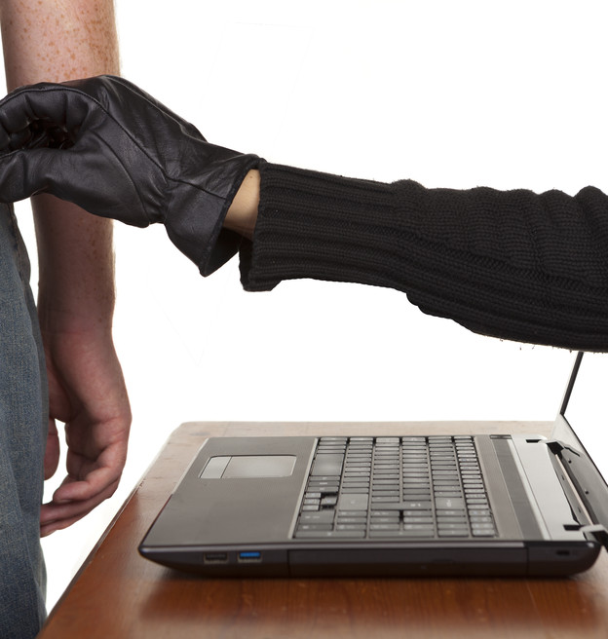
HOW TO BETTER PROTECT YOUR INFORMATION
Multi-factor Authentication
User awareness
Connect to secure WIFI networks
Notes:
There are numerous ways in which to be bale to protect your privacy while using the internet. One effective measure is multi-factor authentication. Multi-factor authentication can be used when a computer user is requesting access to help ensure another level of protection. Before a user is granted access to an account they must sign in on another device such as your mobile device. This helps users ensure that they’re the only ones accessing their account. Another way to protect your mobile devices is through user awareness. Be aware of the permissions given to applications. Sometimes apps can access personal information if given the permission. Another way to stay safe is by being skeptical. When using WIFI make sure you are connecting to a secure network. Networks that do not require passwords should not be trusted and avoid using any banking apps while connected to these networks.

Slide 9
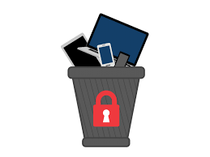
DISCARDING DEVICES
Dispose of them properly
Wipe devices before selling or discarding them
Notes:
When it comes time for a new upgrade remember to completely erase all information on your device. You may be selling your phone to your relative that you trust but they may sell it to someone else so it is best to make sure all your information is completely wiped off the device. Wiping your device ensures that your personal information does not fall into the wrong hands. Even if you feel like there is nothing important on the phone it is still important that you completely wipe all data from it. This can easily be done on your device as many devices have a factory reset option which completely erases all information from the phone. This option can be found in settings.

Slide 10
TOP FINANCIAL TIPS
Start investing & saving early for retirement
Consider advantages & disadvantages of different bank accounts
Create a budget to achieve your financial goals
Establish credit early, build your credit, & avoid hard credit hits
Get advice from a financial advisor or other financial professional/teacher
Cover risks with proper insurance
Always write down your goals & actively chase them down!!
Notes:
In conclusion, we’d like to offer our top financial tips. (Go over bullets listed above)

Slide 11
Thank you for joining us through this EXCITING PRESENTATION! Visit our website farmcreditofnc.com Contact us at: 800-521-9952

