Slide 1
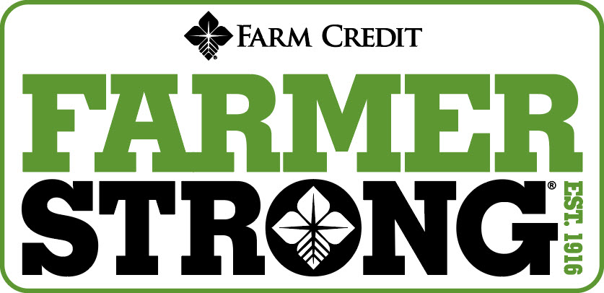
Notes:
Welcome to the Personal Finance Workshop created by the Farm Credit Associations of NC. We hope this presentation will help you with planning your finances for today and preparing for tomorrow.

Slide 2
DEBT MANAGEMENT
STAY AHEAD OF THE GAME
Notes:
Although everyone will most likely have to deal with debts in there life, there are ways to easily manage debt. This will allow you to stay ahead of the game and in control of your finances.

Slide 3
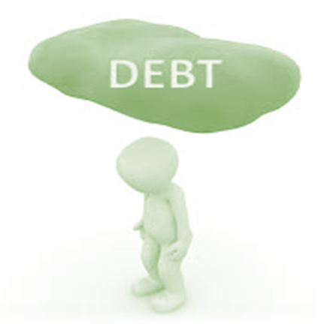
DEBT
A debt is an amount of borrowed money by one party from another.
SECURED: covered by a lien on collateral
Mortgage
Car loan
UNSECURED: not covered by a lien on collateral
Personal loans
Student loans
Credit cards
Repaying debt
Notes:
The first step in debt management is understanding what debt is. A debt is an amount of borrowed money by one party from another. Debts may be used by individuals and businesses alike as a method of making larger purchases that would be unaffordable under normal circumstances.
Debt management is any strategy that helps a borrower repay their debt, or otherwise handle debts better.

Slide 4
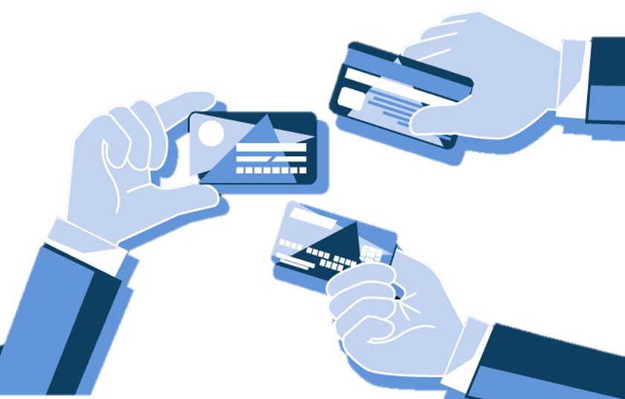
CREDIT CARDS
Easy line of credit
Can you pay for it in cash?
Can help increase your credit score!
Notes:
Credit cards are a quick way to get access to money. They can be very helpful but can also be dangerous. They allow you to purchase anything up to your limit on the card. A good rule of thumb for a credit card is only use it if you can write a check for that amount. Credit cards generally carry high interest rates, and if you only pay the minimum payment amount each month, it can take you years to pay them off. You do not want to run up a bunch of debt on your cards and not be able to pay it off, this will end up hurting your credit score badly.
Although credit cards can be dangerous they can also be beneficial to your credit score. If you have a good amount of open credit cards and are paying them all off each month and keeping the balance to a minimum, this can help your score. It will show that you can handle many different accounts and are able to pay them off each month

Slide 5
WHY IS DEBT MANAGEMENT SO IMPORTANT?
Maintaining financial stability
Benefits
Accelerated payoff
Improve Credit Score
Flexibility
Notes:
Managing your debt is important for your financial stability. It allows you to keep track of your finances and make your finances work for you.
Benefits of managing your debt include accelerated loan payoff, improving your credit score, and increasing your financial flexibility. Managing your debt will help you not only save time and money, but will generally improve your credit score as you maintain on-time payments. If you manage your debt, you will have more financial flexibility when unexpected debts arise.

Slide 6
DIY DEBT MANAGEMENT PLANS
Create a Reduction Spreadsheet
Some debt reducing methods include:
Snowball Method
Avalanche Method
Notes:
One way to effectively manage personal debt is to create a debt management plan. These plans require you to look at your current spending habits, budget, and liabilities/debt. Two common plans include the Snowball and Avalanche Methods.

Slide 7
METHODS OF MANAGING DEBT
Step 1: List all debts smallest to largest
Step 2: Pay on smallest debts first until paid out
Step 3: Once smallest debt is paid, apply money to next
Snowball Method
Notes:
List debts from smallest to largest, REGARDLESS of interest rate. Pay each minimum payment on all debts EXCEPT the smallest one.
Pay as much as possible towards the smallest debt until it’s paid off completely. Once that debt is gone, apply that payment to the next smallest debt on your list while still paying minimums on your other debts.
Keep applying payment to the next smallest debt, and repeat this method until all debts on your list are cleared.

Slide 8
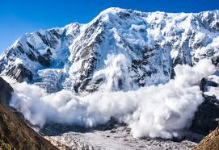
METHODS OF MANAGING DEBT
List all debts by order of interest
Pay extra on debt with highest interest rate
Pay highest debt off and apply payment to next highest debt
Avalanche Method
Notes:
The Avalanche method is used to eliminate debt by organizing payments by interest rates. The goal is to minimize how much interest you pay, which may help pay off debts faster.
List debts by order of interest rate, starting with the highest rate down to the lowest rate
Make minimum payments on all debts, paying extra on the highest rate. You're reducing the amount owed at that high rate.
Once you pay off a loan, move to the next highest interest rate and continue this cycle until all debts are paid off

Slide 9
Thank you for joining us through this EXCITING PRESENTATION! Visit our website farmcreditofnc.com Contact us at: 800-521-9952

