Slide 1


Notes:
Welcome to the Personal Finance Workshop created by the Farm Credit Associations of NC. We hope this presentation will help you with planning your finances for today and preparing for tomorrow.

Slide 2
BUDGETING
PUTTING MATH TO GOOD USE
Notes:
In this section we discuss the basics of budgeting and guide you through a simple percentage breakdown of your monthly income. We will also look at how to get started and some various budgeting tools you may find helpful to stay organized.

Slide 3
WHAT IS A BUDGET ANYWAY?
Budget: Record of income and expenses for a given period of time.
Measuring the flow of money, what’s going in and what’s coming out
  Income and expenses
Track the flow of money so you can control where your money goes
Types of budgets: Paper budgets, Excel spreadsheets, the envelope system, Mobile apps
How does it work in real life?
Activity 3 and 4
Notes:
So what is a budget anyway?
(read definition and bullets from the slide)

Slide 4


BUDGETING EQUALS LESS STRESS INTRODUCTION TO BUDGETING
Budgeting breakdown
Not one size fits all
Monetizing your expenses
Notes:
Budgeting is a tool that enables financial planning and control over resources, those resources include time and money. The budget process involves planning for future profitability. A budget assists in balancing your income with your expenses.
By prioritizing your monthly income based on a budget break down best suited for your needs, it will enable you to reach your personal and financial goals. The most common budget breakdown is denoted as 50/20/30; allocating 50% of your monthly income for needs, 20% to paying off debts and establishing a savings, and 30% for discretionary spending. This breakdown of 50/20/30 is an on-average budgeting system which may be inadequate for your own financial goals.
When budgeting, there is not a “one size fits all” method. According to John Csiszar, a budget that works well for you is one that allows you to comfortably pay all your bills, save for retirement and enjoy yourself.
Monitoring your expenses throughout the month holds you accountable for your finances. By tracking your purchases, you are able to see exactly how your money is being allocated each month which will lead to better and more profitable decision making. On the other hand, not tracking spending can often result in the accrual of debt.

Slide 5

BUDGETING IN REAL LIFE
INCOME
  Paycheck
  Rent Income
  Interest Earned
  Investment Income
EXPENSES
  Things you have to pay – rent, mortgage, electric bill, car insurance, groceries, etc.
  Optional items you pay for – Starbucks coffee, Netflix, Chick-fil-A, new shirt from Belk, 4-wheeler, etc.
Notes:
Budgeting can be broken down to income and expenses. Income is just as it says, all money coming into your bank account. This can include your paycheck, rental income, interest earned, and investment income.
Expenses include everything that you spend your money on. Basically this will be things you have to pay like rent, mortgage, electric bill, car insurance, groceries, etc. It also includes those optional “want” items like Starbucks coffee, Netflix, Chick-fil-A, a new shirt from the mall, a 4-wheeler, etc.

Slide 6
BUDGETING IN REAL LIFE
INCOME – EXPENSES = SURPLUS or DEFICIT
Surplus
  Extra money left over for saving or investing
  Extra money left over for some fun things in life
Deficit
  Spending more money than you are making
  If this goes on for a few years it can sink your financial boat
Notes:
By taking your income and subtracting your expenses, you will end up with a surplus or a deficit.
A surplus means you will have extra money leftover for saving, investing, or some fun things in life.
A deficit means you are spending more money than your are making. If this goes on for too long, it can sink your financial boat very quickly!
This is why it is important to come up with a plan ahead, also known as a budget.

Slide 7

PERCENTAGE OF INCOME BREAKDOWN
50%
SAVINGS
Emergency Fund
Essential Expenses
Retirement Savings
NEEDS
Housing Cost
Groceries
Utilities
Healthcare Costs
Transportation
DEBT
Student Loans
Credit Card
Other
20%-30%
DISCRETIONARY SPENDING
Entertainment
Vacations
Technology
20% - 30%
Notes:
When prioritizing your expenses, you may want to categorize your budget into savings and debt, needs, and discretionary spending. Dave Ramsey suggests the 50/20/30 breaking down your monthly income into percentages.
First, allocate 50% of your monthly income for your needs. Of that 50 %, on average…
25-30% should be used to pay for your housing
10-15% should be utilized for groceries
5-10% should be put toward the cost of utilities
5-10% should be allocated for healthcare costs
And 10-15% should go towards paying for your mode of transportation.
Once you allocated for your monthly expenses, then you should portion about 20 to 30% of your income towards getting out of debt and building your savings.
First, you should establish an emergency fund ($1,000). This should cover any unexpected expenses that may arise.
Once you have established an emergency fund as a safety net, then you should begin paying off any incurred debt, other than housing and transportation costs. This includes student loans, credit cards, and any other outstanding balances that may hinder your financial flexibility.
After you have paid most of your debts, it is a good idea to establish a fund that allocates money for 3 to 6 months of essential expenses. Once you have established a healthy savings account, you may want to consider allocating 10 to 15% of your savings for a retirement account.
Your monthly allocation for discretionary spending may vary from month to month depending on your circumstances. You may save more and spend less on yourself while planning for a vacation. You may treat yourself at the end of a long month at work. Or even repay yourself. Either way, on average, you should allocate about 20 to 30% of your monthly income for discretionary spending.

Slide 8
STEPS TO CREATING A BUDGET
Step 1
Step 2
Step 3
Step 4
Compare your spending to your budget
Set personal and financial goals for yourself
Assess your situation
Write down your total monthly income
Live within your means
Write down your monthly expenses
Review your progress and revise your budget if needed.
Track your expenses throughout the month
Notes:
When creating a budget you want to begin by recording your total monthly income. A good rule of thumb for those trying to build their savings is to subtract your monthly savings allocations before you begin your budget. This eliminates the method of only saving what is left over in your current budget.
You should list all of your expenses for the month, making sure to include any fees or insurance that may apply. From this, you should subtract your total expenses form your monthly income to see the bottom line of your budget. If you are left with a positive number, you’re living within your means. If your sum is negative, that means your expenses are higher than your income which could result in the accrual of debt. This is referred to as living out of your means. If you are over budget try cutting back your allocation for discretionary spending first before decreases the amount of money allotted for your debt and savings.
In order to stay on track with your budget, continuously update your incurred expenses throughout the month. There a many different tools and apps designed to track your spending as well.

Slide 9
BUDGET SPENDING SUGGESTIONS
Notes:
(Discuss the different spending suggestions.)

Slide 10

MANAGING YOUR BUDGET
Increase income
  Afterschool/weekend job
  Babysitting
  Helping neighbors with chores
Reduce spending
  Coupons
  Smart shopping
  Avoid impulse purchases
  Eat at home
Notes:
Once you have planned out your budget it is important to manage and revisit it very often. Always check your progress as you go throughout each month. Don’t wait until the end of the month. If you are not bringing in enough income, consider ways to increase your income. (go through list of examples above). You should also think of ways to reduce your spending. (go through list of examples above)

Slide 11

TOOLS TO HELP YOU BUDGET
Dave Ramsey’s EveryDollar Budget App
Spreadsheet/Downloadable templates
Personal Monthly Budget Sheet
Dave Ramsey’s Budgeting Forms
Notes:
Numerous tools can be found online that are designed to make budgeting easy and efficient.
Dave Ramsey’s EveryDollar is a budgeting app that tracks your spending and form that creates a personalized monthly budget. Essentially this app tracks where every dollar goes in order to formulate a conservative monthly spending plan.
For those who wish to utilize a hard copy, Dave Ramsey also provides a printable budgeting form. This form provides the basics of monthly budgeting. However, user calculations are necessary if you chose to use this form.
In addition to these tools, there are numerous downloadable and printable spreadsheets available online. It is important when selecting a tool to use, that you select the one that is best suited for your needs and is easiest to utilize.

Slide 12
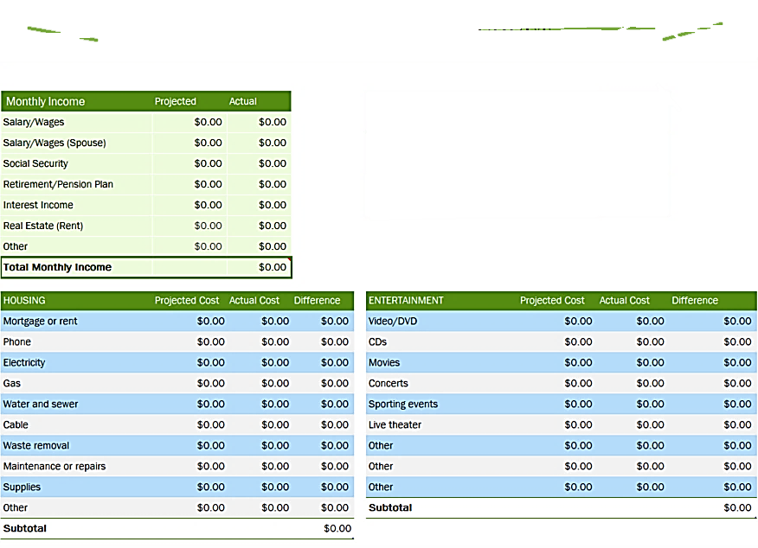
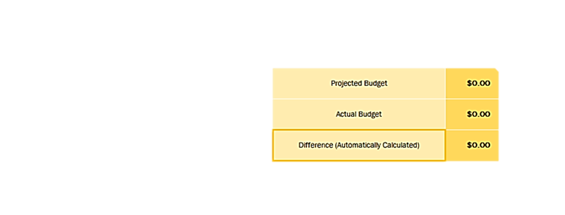
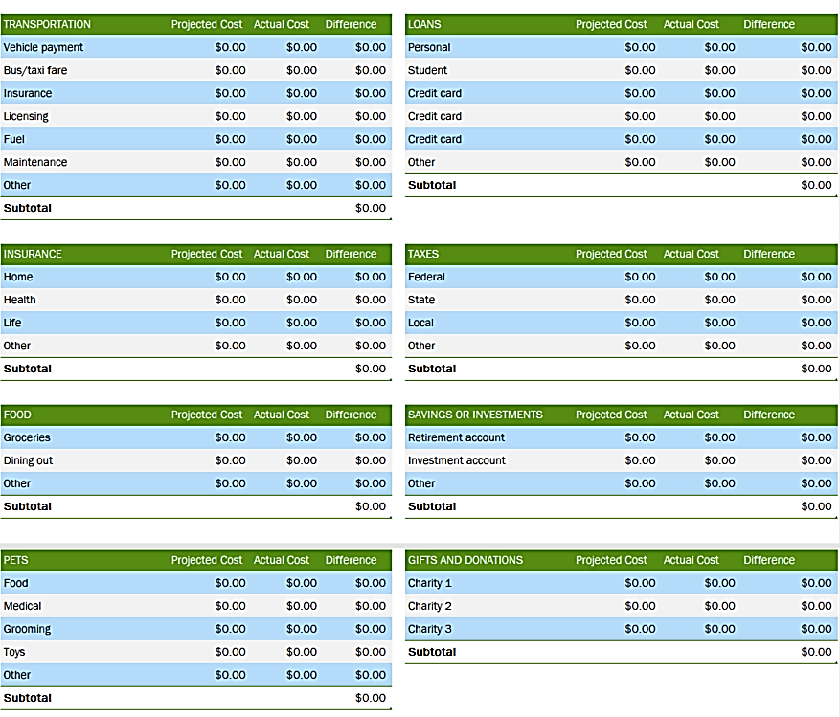
Personal Monthly Budget
Notes:
Here is an example of a personal monthly budget.
This form specifically allows you to create a projected monthly budget prior to the start of the month. During the month, this sheet breaks down the average monthly expenses of items from electricity and automobile insurance to personal care and pets.

Slide 13
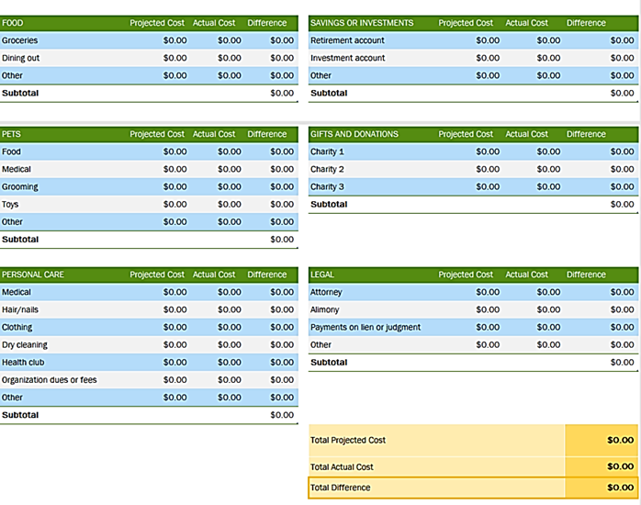
Notes:
By establishing the difference between your projected budget and actual budget, it determines the flexibility of your budget.

Slide 14
BUDGETING – Review Questions
What is a budget?
How can you track your spending?
What percentage of your income should you set aside for your savings?
What are two ways that you can increase your cash flow?

Slide 15
FINANCIAL GOAL SETTING
THE SMARTY WAY
Notes:
Now you might be wondering, how do I make my finances fit into my life goals?? The answer is by not just setting life goals, but by also setting financial goals using the SMARTY way.

Slide 16
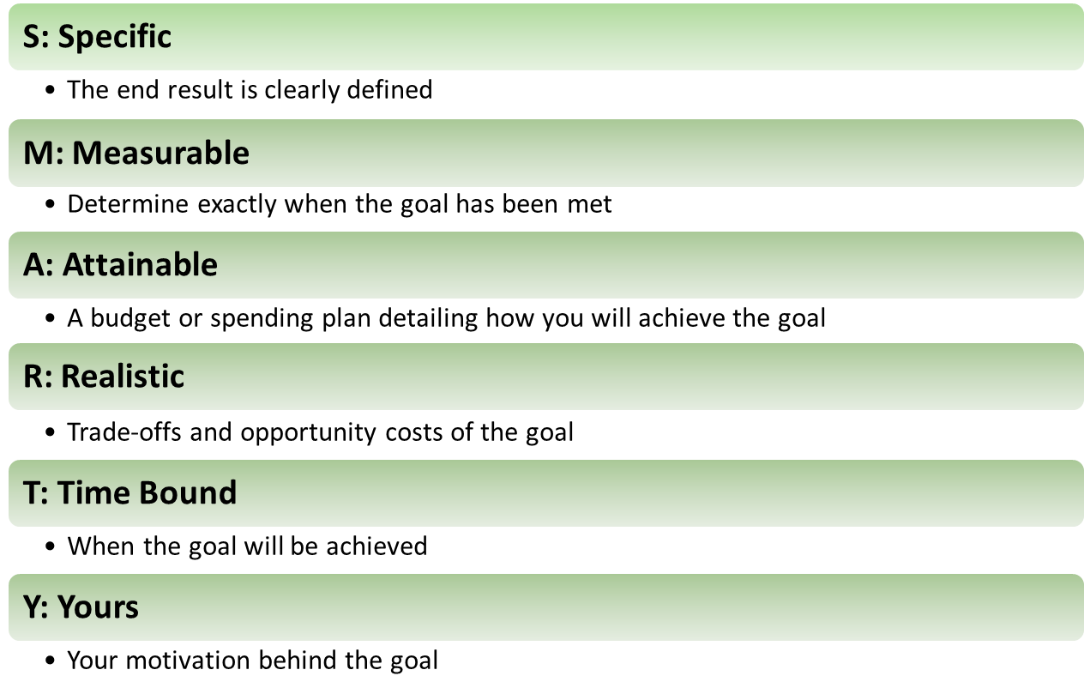
GOAL SETTING MADE EASY
Financial goal setting is a significant factor to achieving long term financial goals.
Financial goals should be SMARTY
Notes:
(Go over bullets and definitions listed above) Specific – definition and detail, Measurable – track your progress, Attainable – nothing unrealistic, Relevant – based on your needs and values, Timely – Set a deadline, Yours – your motivation behind the goal

Slide 17

Financial Goal Setting
Example of a financial SMARTY Goal: I will pay off the amount I owe on my car loan in 2019 by paying an extra $100 per week. I will pay off this loan amount because I want to be debt free before buying a house.
Activity 2
Notes:
(Go over example listed)

Slide 18
TAKE NOTES
ALWAYS WRITE DOWN YOUR GOALS!
  Short term
  Long term
Goals are the foundation of your financial plan
Goals are the starting point for saving and investing
Notes:
It is always important to actually write down your goals. People who write down their goals have been shown to be more likely to achieve them. Keep in mind that there are two types of goals, short term and long term. Short term goals include things you plan to accomplish within a year or less. Long term goals will be carried out in the future. (Go over last two bullets listed above)

Slide 19
FINANCIAL GOAL SETTING – Review Questions
Why would a goal need to be time bound?
What is an opportunity cost?
What is a goal?

Slide 20
Thank you for joining us through this EXCITING PRESENTATION!
Visit our website farmcreditofnc.com
Contact us at:
800-521-9952

