Slide 1
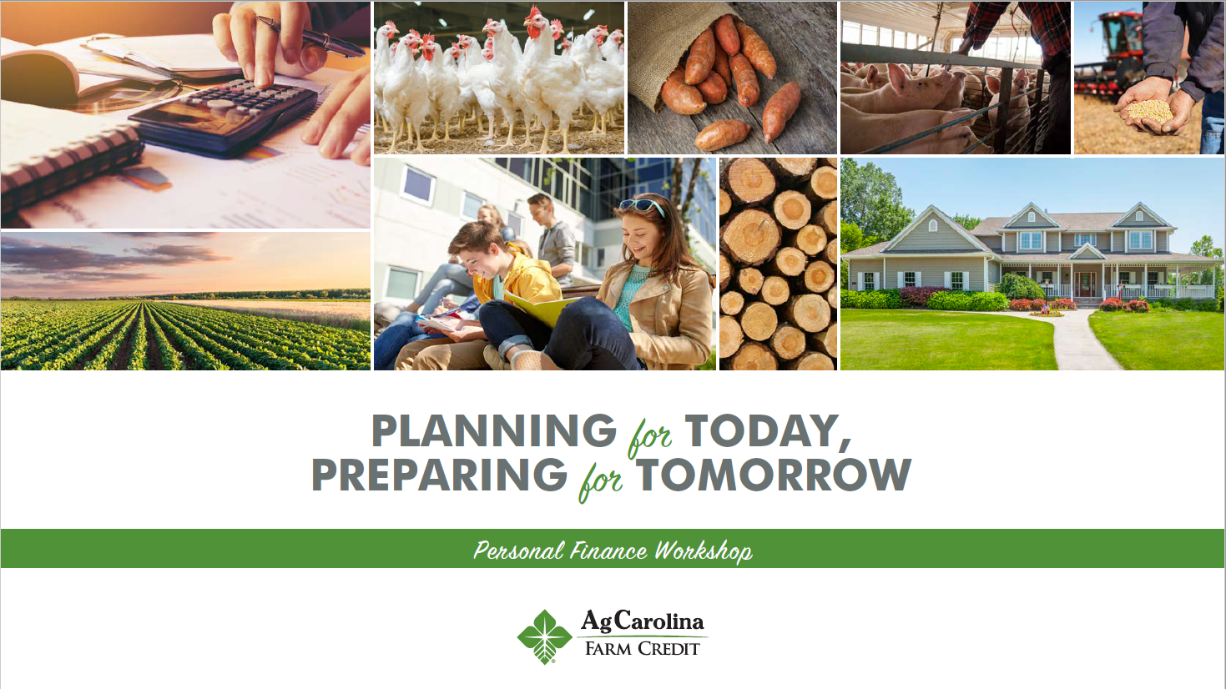

Notes:
Welcome to the Personal Finance Workshop created by the Farm Credit Associations of NC. We hope this presentation will help you with planning your finances for today and preparing for tomorrow.

Slide 2
CAREER PLANNING & TAXES
THINGS TO CONSIDER
Notes:
Now that we’ve discussed what to do with the money you earn, let’s look into planning a career to help you earn that money and how taxes come into play.

Slide 3
CAREER PLANNING
When choosing a career, you should consider: salary, opportunities, time-off, and benefits
Gross salary: Stated salary
Net salary: The amount you take home after all deductions and withholdings have been made.
Notes:
(Go over bullets listed and elaborate on Gross and Net salary)

Slide 4
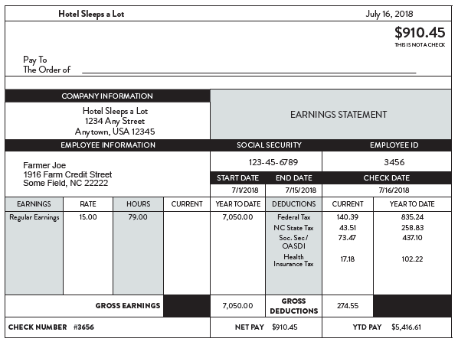
UNDERSTANDING YOUR PAY STUB
Notes:
A pay stub is a form, produced by your employer, that breaks down your hours worked per pay period, the gross amount of money you earned, all taxes, healthcare costs, and other funds that were deducted from your gross earnings, and your net pay, or the amount of money that you will receive when you cash your paycheck.
(Explain the following components of the paystub: Gross income, net income, federal income tax, state income tax, social security, medicare, year to date savings.
Also give an explanation of how companies determine how much to take of your paycheck for taxes, i.e. the W-4)

Slide 5

TAXES
No matter how much we dislike them, we all have to pay them!!
Property tax
Sales tax
Income tax: State and federal
2018 Federal Income Tax Brackets
% of Income | Single Filers | Married Filers
10% | $0-$9,525 | $0-$19,050
12% | $9,526-$38,700 | $19,051-$77,400
22% | $38,701-$82,500 | $77,401-$165,000
24% | $82,501-$157,750 | $165,001-315,000
32% | $157,751-$200,000 | $315,001-$400,000
35% | $200,001-$500,000 | $400,001-600,000
37% | $500,000 or more | $600,000 or more
Activity 5
Notes:
(Discuss the purpose of taxes.) Taxes are fees so we can enjoy amenities provided by the government.

Slide 6
SPOILER ALERT!!!
TAXES CAN BE REDUCED
  Pre-tax retirement/investment plans are not taxed until they are withdrawn
  Roth retirement/investment plans are funded with after-tax dollars, but if certain requirements are met, withdrawals are federal income tax free
  Watch out for penalties
    Making certain withdrawals too early
Notes:
Although taxes may seem like a necessary evil, there are ways you can reduce the amount of taxes you pay each year. Taxes can be reduced by using pre-tax retirement plans, like the IRAs we discussed previously. Traditional IRAs are not taxed until funds are withdrawn when you retire. Roth IRA plans are funded with after-tax dollars, but if certain requirements are met, withdrawals are federal tax income free. Each year, you will have to complete your state and federal tax returns by April 15th. If you have an accountant prepare your tax returns, it is always important to ask them about ways to reduce your taxes. You should also check with your financial advisor about any penalties for withdrawing money early from your investments and retirement accounts.

Slide 7
CAREER PLANNING & TAXES – Review Questions
What is the difference in gross and net income?
What is an example of a tax withholding?
Name one type of benefit your employer may provide to you.

Slide 8
FARM CREDIT
WHAT WE DO
Notes:
So what is Farm Credit? Through this section, we’ll look at what Farm Credit does, the purpose it serves, and a little bit about our big passion for agriculture.

Slide 9
FARM CREDIT
The FC System
Member owned cooperative
Key elements in history
Woodrow Wilson: Federal Land Bank System
1916
Member-owned and member-controlled
1916: Long term lending
1930s: short-term and intermediate lending
100+ years of serving farmers
Notes:
Farm Credit Is a member-owned lending cooperative, created by Congress in 1916 to provide those in rural America with a dependable source of financing.
Based off of a cooperative model it is a member-owned and member-controlled business that distributes benefits to the basis of the use/user (patronage)
President Woodrow Wilson signed legislation creating the Federal Land Bank System in 1916 and since then we have evolved into 72 independent financial institutions. 1916 marked the time of long term lending abilities through Farm Credit, and in the 1930s farmers were able to have short or intermediate lending as well. Farm Credit has been serving farmers and rural America with reliable and dependable credit services for over 100 years.

Slide 10
THE FARM CREDIT LOGO
Leaves: types of lending
Roots: member-borrowers
Star: light and direction
Used within every associations logo
A reputation encompassing Farm Credit’s services and ongoing actions
Notes:
The BioStar is a symbol of progress and commitment consisting of five visual elements: three leaves, a root system, and a star. The leaves represent the three types of lending done by the Farm Credit System – long-term, intermediate-term, and short-term. The roots represent our member-borrowers, and the star represents light and direction. The BioStar is used in the national logo and many System entity logos. It is much more than a logo; it symbolizes the reputation FC has built over many years. It’s the sum of all the tangible and intangible characteristics that make Farm Credit unique, encompassing the services we deliver, the ways we connect with our members, the messages we communicate, and the look of our marketing materials (go over each bullet listed above)

Slide 11


WORKING AT FARM CREDIT
Team based collaborative atmosphere
Communication
Playing a role in agriculture
Face-to-face interaction with customers
Multiple career opportunities:
  Loan Officer
  Appraiser
  Credit Manager
  Loan Processor
  Branch Office Coordinator
  Human Resources
  Operations & Accounting
  And many more!
Working at Farm Credit allows the individuals to play a role in agriculture financially!
Notes:
Working at Farm Credit the employees are in a collaborative atmosphere where they have the opportunity to communicate and work with other employees as well as customers. With this atmosphere there is a lot of multitasking that goes on daily in the office.
As employees work in the office they are also involved with their customers outside of the office. This can include visiting a farm, home construction site, potential land properties, sponsorship events, livestock shows, etc. Our lenders work closely with customers to best meet their needs and create a relationship with them. If you’re interested in learning more about working for Farm Credit, head on over to the Careers page on our website.
(Go over the bullets listed on the slide)

Slide 12
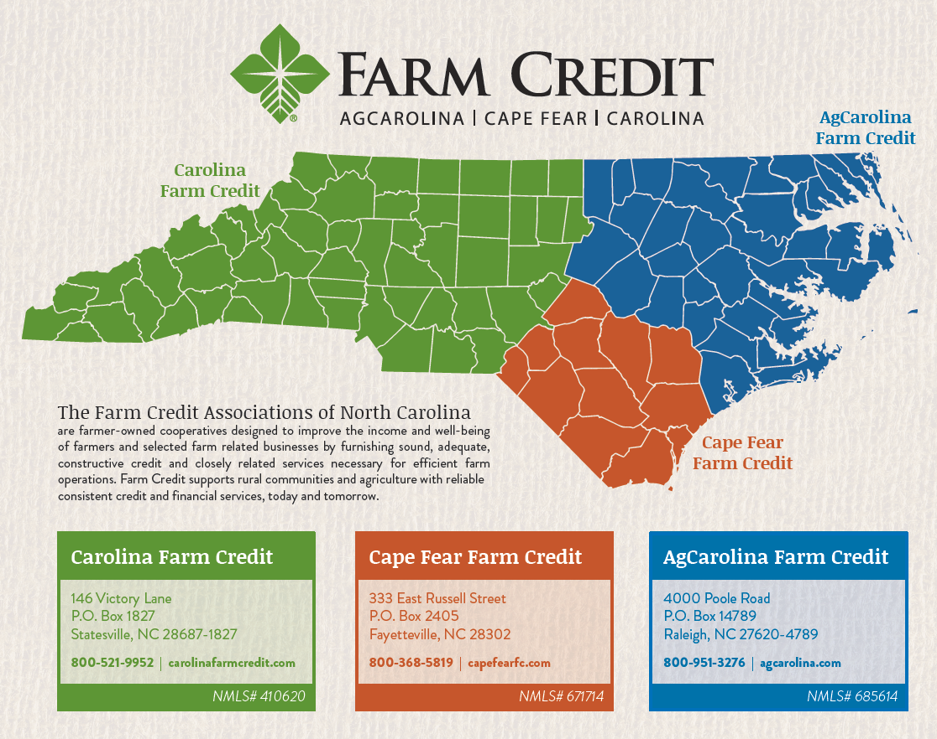
3 FARM CREDITS OF NORTH CAROLINA
AgCarolina, Cape Fear, & Carolina
Loans to rural residents across the state
$3.9 billion in loans to 17,650 customers
Source of credit for farmers & rural residents
Notes:
North Carolina farmers and rural residents can qualify for loans for farms, homes, agribusinesses and more from 1 of 3 Farm Credit Associations in North Carolina, with branch offices across the state. These 3 Associations include AgCarolina Farm Credit, Cape Fear Farm Credit, and Carolina Farm Credit. We're part of the national Farm Credit System, which has been serving the credit needs of rural America for over 100 years. With our long tradition, local know-how and agricultural expertise, we provide our members with a dependable source of credit generation after generation. More than $3.9 billion in loans are outstanding to more than 17,650 members who own our 3 cooperative Associations.
Our directors are also farmers, and they oversee our organization to protect the interests of our members at all times.

Slide 13
Thank you for joining us through this EXCITING PRESENTATION!
Visit our website farmcreditofnc.com

