Slide 1
Notes:
Welcome to the Personal Finance Workshop created by the Farm Credit Associations of NC. I am AJ Moore, a loan officer with Farm Credit in Elizabeth City, NC. I look forward to sharing valuable information with you to help as you plan your finances for today and prepare for tomorrow. Let’s get started!

Slide 2
RETIREMENT & INVESTING
PLANNING FOR THE FUTURE
Notes:
In this next section we will dive into planning for the future with insurance, retirement, and investing.

Slide 3
WHY DO I NEED INSURANCE OR A RETIREMENT ACCOUNT WHEN I’M YOUNG AND HEALTHY? BLOCKING THE COST OF RISK
Health
Auto
Life
Disability
Long-term care
Property
Notes:
You might ask yourself, why do I need insurance or a retirement account when I’m young and healthy? The answer is, to block the cost of risks in your life. Risks can come in the form of health problems, auto accidents, disability, property damage due to a hurricane, etc. With so many risks, insurance offers a financial safety net to cover the costs associated with these risks.
Your retirement, on the other hand allows you to plan for life once you complete your career. Although that may seem years away, it is important to start planning now.

Slide 4
MINDSET FOR STARTING YOUNG
Visualize what you want
It’s not your money, it belongs to your future
Don’t take too many risks
Notes:
The first step to starting young is to visualize what you want. Picture what you want your retirement lifestyle to be like then plan around that. It is important to not touch the money and understand that it is not your money right now, it is for the future you. Don’t take too many risks with it. Buy and hold for the long term.

Slide 5
RETIREMENT PLANS
Planning which helps an individual be financially stable after they retire
There are numerous types of retirement plans
Notes:
Now to transition to Retirement plans. Many people when asked what their retirement will look like, they mention vacation and enjoying life. This sounds great but where will the funds come from to finance these trips? This is where the role of retirement plans come into play. Retirement plans involve planning which helps an individual be financially stable after they retire. There are numerous retirement plans, including 401Ks and IRAs.

Slide 6
Retirement
Based on your current age, it is estimated that the following amounts will be needed at the age of 65 to retire:
25 year old: $3-4 million
35 year old: $2-3 million
45 year old: $1-2 million
Save 10-15% of your annual income for retirement.
One million dollars today will not be worth one million dollars in 20 years due to inflation & the future value of the US dollar.
Notes:
Before you choose a retirement plan, it is important to figure out where to begin and how much you should save. (go over bullet 1)
The goal that most financial advisors suggest is to (go over second bullet)
(go over third bullet)

Slide 7
WHERE TO BEGIN
Know how much money you have available to use
Understand how much risk you are willing to take
Diversify your portfolio
Pick a place
Never invest more than you can afford to lose
Notes:
There are 5 simple steps when looking at where to begin when retirement and investing. First off is to know how much money you have for investing. One popular rule of thumb is the “100 minus age” rule, which means you take 100 and subtract your age from that. The resulting number is the percentage you should allocate to stocks. For example if you are 30 then 70% of your assets should be allocated to stocks. This is just a general rule and others may find it better to use less or more. 2nd is to understand how much of a risk you are willing to take. There are some funds that are low risk, low reward and others high risk, high reward. It all comes down to what’s best for you. 3rd is to diversify your portfolio. You do not want all your eggs in one basket. Make sure you are diversified. Being diversified means to make sure that you have stocks that are in various industries. Sometimes the medical stocks preform well or sometimes banking stocks so it is important to not have all your stocks in one industry. 4th is to pick a brokerage account that best fits you or employer sponsored accounts such as 401 (k). 5th is to never invest more than you can afford to lose. There’s a chance you may lose money so for safety reason it is best to invest an amount that you can afford to lose.

Slide 8
SAVING FOR RETIREMENT IS EASIER THE EARLIER YOU START SAVING
Retirement amount
Depends on the lifestyle you want to live in retirement
When to retire?
Retiring earlier = shorter period of time to build funds
How long will retirement funds last?
25 years or longer
401K/403B plans
Tax friendly
Employer matched
IRAs – Traditional and Roth
Notes:
(Go over items listed)

Slide 9
401 (K) PLANS
Employer sponsored account that comes out of your paycheck
Employers can match up to a certain percentage which is equivalent to free money.
Withdrawing the funds early can result in a penalty
Notes:
The first type of retirement plan which is one of the more popular is the 401(k) plan. This is a workplace retirement account that’s offered as an employee benefit. By using this it could help eliminate the amount of income you pay taxes on. These are great options as many employers match your contributions up to a certain percentage. For example, some companies can match your 401K investment up to 6%. In other words, if you invest 6% of your salary into your 401K account, the company will also invest 6% into your account. There are a few negatives such as withdrawing EARLY. If you withdraw funds before the age 59 ½ then you are subject to a 10% penalty. There are also contribution limits, as of 2020 the limit was set to $19,500. Overall this is a great plan with low risk.

Slide 10
INDIVIDUAL RETIREMENT ACCOUNTS (IRAs)
Make investment decisions yourself
Grow quickly
You can buy and sell investments in stocks, bonds and mutual funds, and any other type of investment
Notes:
If your employer does not offer a retirement plan or if you have already maxed out your 401K then you may want to invest in an Individual Retirement Account, better known as an IRA. With an IRA you can contribute up to a specified amount as determined by the IRS. If you are age 50 or older, you are able to contribute an additional amount as part of the “catch up” provision. If you select traditional IRA, your contributions will be tax-deductible in the year in which they are made. An IRA has the same stipulations as a 401K when it comes to withdrawing money before 59 ½ which is a 10% penalty.

Slide 11
TYPES OF IRAs
Roth
SEP
Great if you’re self-employed and have no employees.
Contributions are made with after-tax dollars
Withdraw money before retirement with no penalty
Cash grows extremely fast
Deduct these contributions from your taxable income.
Max annual contribution limits of $57,000 or 25% of income- whichever is less
Traditional IRA
Deduct contributions now and pay taxes on withdrawals later
Upfront tax advantage
No income eligibility restrictions
Notes:
There are several different types of IRAs.
A ROTH IRA is a great start with retirement plans. Contributions to a ROTH IRA are taxed beforehand, withdrawals are never taxed and it grows at a rapid rate. It is great place for when you’re just starting out and have extra money you want to use. You can invest in an IRA and ROTH IRA but your total contributions to both can not exceed the specified limit for the year.
Simplified Employee Pension or SEP IRAs allow you to contribute a portion of your income to your own retirement account. These accounts are great if you’re self-employed and have no employees. The max annual contribution limits are significantly higher than the other accounts as you can contribute up to $57,000 or 25% of your income in 2020, whichever is less.
A Traditional IRA allows you to deduct contributions on your current taxes and not have to pay taxes until you withdraw funds later in retirement. These accounts do not have any income eligibility restrictions. They also offer an upfront tax advantage.

Slide 12
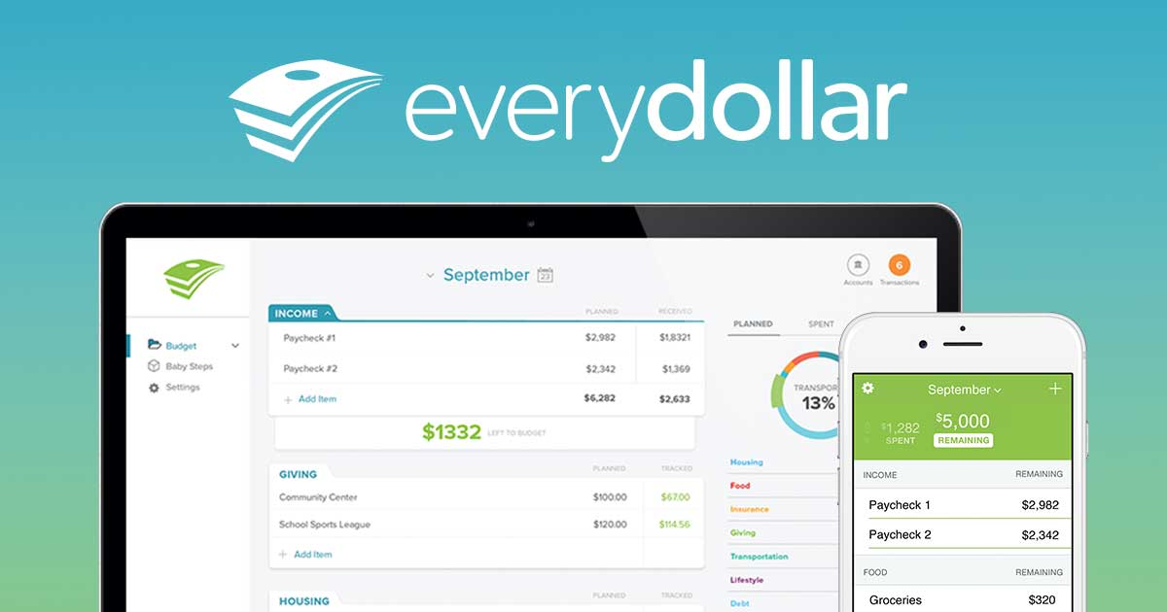
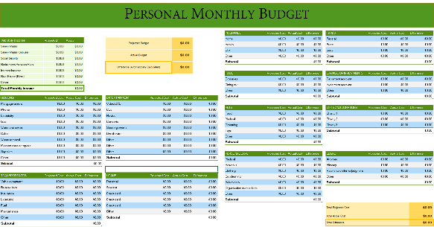
TOOLS THAT MAY HELP
Dave Ramsey “Every dollar” app
Basic spreadsheet
Invest 10-15% of household income to retirement plan
Notes:
These tools may assist you in budgeting your money for your retirement and investing plan. Dave Ramsey offers an app that helps you keep track of your money usage so you can see where every dollar goes to throughout the month. A basic spreadsheet can also be helpful for creating a budget to set aside money for your retirement planning. A good tip is to aim to invest 10-15% of your household income to your retirement plan. If you do that when it comes time for retirement you will be ready to do whatever you choose to do to enjoy your time.

Slide 13
INVESTING
Investing: Expend money with the expectation to achieve profit.
The more you know the more successful you will be!!
Putting your money in an account that draws interest from different companies
More risk equals more potential earnings on your account
Less risk equals less potential earnings on your account
401K, IRA, etc.
If your budget allows, always max out your employer matched contributions
Notes:
In a financial sense, investing is when an individual commits money to a financial asset, or security, such as a bond or stock, in hopes of receiving more money in the future. Investing can be seen as risky and overwhelming but with these basic understandings, hopefully investing will begin to take shape and you can develop a clearer understanding.
(read through bullets listed)

Slide 14
INVESTING
Your age = The percent of your portfolio in “safer” investments
Bonds, bond mutual funds, CDs, etc.
100 – Your Age = The percent of portfolio in “riskier” investments
Stocks, stock mutual fund, real estate
Based on this rule, you should have riskier investments earlier in life and safer ones later in life.
Notes:
There is one quick way to look at your investment strategy. Your age should equal the percent of your portfolio that is held in safer investments like bonds, bond mutual funds, CDs, etc. If you take 100 minus your age, that should equal the percent of your portfolio that you should place in riskier investments like stocks, stock mutual funds, real estate, etc. Based on this rule, you should have riskier investments earlier in life and safer ones later in life.

Slide 15
INVESTING
Risk averse refers to a person who prefers lower returns with known risks rather than higher returns with unknown risks.
What is your risk tendency?
Activity 7
Notes:
In the world of investing, riskier investments earn a greater return and less risky investments earn a lower return. When talking with a financial advisor you might hear the term risk averse. This refers to a person who prefers lower returns with known risks rather than higher returns with unknown risks. It is important to ask yourself, what is my risk tendency?

Slide 16
TIME VALUE OF MONEY
Time value of money: the concept that money available today is worth more than the future identical sum because of investment potential.
The formula for time value of money is: Future value = present value (1+(i/n)) ^{(n * t)}
i = Interest rate
n = Number of compounded periods
t = Time
Activity 8
Notes:
(use definition and example given)
Your money grows because of compounding interest. Now let’s look at an example of this money growth.

Slide 17
PLANT YOUR MONEY AND WATCH IT GROW!!
Lindsey
Jackson
Starts saving/investing at age 19
Stops saving/investing at age 27
Puts $2,000 in the account from her paycheck each year
If her account earns an annual average of 10% interest
At age 65 her account will have $1,035,148
Starts saving/investing at age 27
Stops saving/investing at age 65
Puts $2,000 in the account from his paycheck each year
If his account earns an annual average of 10% interest
At age 65 his account will have $883,185
Notes:
This example shows the importance of starting to save earlier in life. It highlights the importance of the time value of money and compounding interest.
As shown (go through the scenarios listed)
Lindsey invests one-fifth the dollars, but has 25% more to show in the end
Returns are hypothetical and are not meant to imply the future performance of any investment, because all investments and rates do change over time.

Slide 18
RETIREMENT & INVESTING – Review Questions
How much money would a 25 year old need to retire?
What is an advantage of starting to save for retirement at an earlier age?
What does it mean to be risk averse?
What type of account can return you the most interest?
Notes:
I encourage you to think through each of these review questions and discuss with your teacher or peers to ensure you grasp these concepts.

Slide 19
Thank you for joining us through this EXCITING PRESENTATION! Visit our website farmcreditofnc.com Contact us at: 800-521-9952
Notes:
As you can tell, providing personal finance education for students is important to Farm Credit. Today’s presentation is part of an eight-part series, so I encourage you to explore the other topics. To contact us, feel free to visit www.farmcreditofnc.com. Thank you for joining me!

