Slide 1
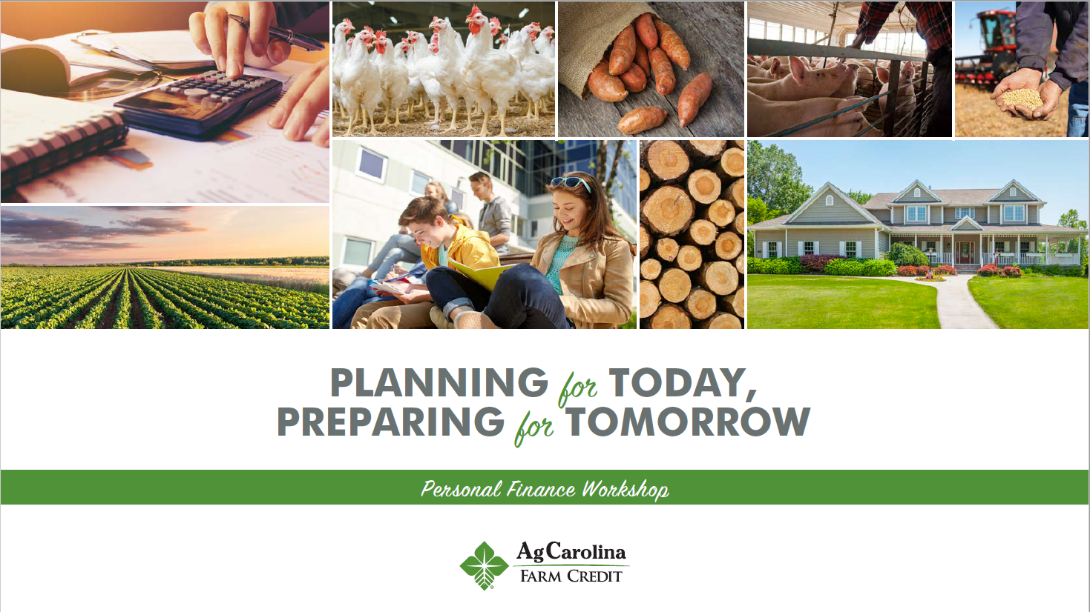

Notes:
Welcome to the Personal Finance Workshop created by the Farm Credit Associations of NC. We hope this presentation will help you with planning your finances for today and preparing for tomorrow.

Slide 2
START TODAY
Where do I begin?
Who should I talk to about finances?
What are all these crazy words like collateral, insurance, and lien?
Why is this even important to me?
How do I win this financial game?
HOLD ON TO YOUR SEATS, HERE WE GO!
Notes:
With finances it is important to start today. So hold onto your seats, because here we go! We’ll help answer some important questions like . . . (list above).

Slide 3
Overview
Introduction & Types of Accounts
Checking Accounts
Savings Accounts
Loans & Credit
Retirement & Investment
Taxes
Creating a Budget
Financial Goal Setting
Record Keeping
Debt Management
Personal Financial Safety
Farm Credit Overview
Notes:
This workshop will give an in-depth overview of . . . (list above). It will address all of the concepts needed to complete the activities and answer the review questions in the workbook.

Slide 4
Introduction
70% of US citizens are living paycheck to paycheck, regardless of income.
A poll found that only 1/3 of Americans maintain a household budget.
Personal Finance: All financial activities and decisions that an individual or household has to make.
Notes:
Here are some interesting facts to get us started on the topic of personal finances. (Read bullets)

Slide 5

Types of Financial Accounts
Checking Account
  Easy access to money
  Linked to debit card and checkbook
  Low interest rate
Savings Account
  Higher interest rate than checking
Money Market
  Larger deposits
  Limited withdrawals
  Larger interest rate than savings account
Certificate of Deposit Account (CD)
  Funds set aside for a period of time to draw
  interest
Investment Account
  Deposit of funds into an account that draws interest from different companies
Notes:
There are 5 types of financial accounts that will be covered: (list above). Each account is used to accomplish a different financial task or goal. (go through the bullets for each account)

Slide 6
CHECKING ACCOUNTS
SAFELY STORING YOUR MONEY
Notes:
One of the most widely used financial accounts is the checking account. A checking account is depository account used to safely store and access your money. Although most checking accounts do not draw any interest, some draw a small amount. Your checking account is linked to your debit card and checkbook.

Slide 7
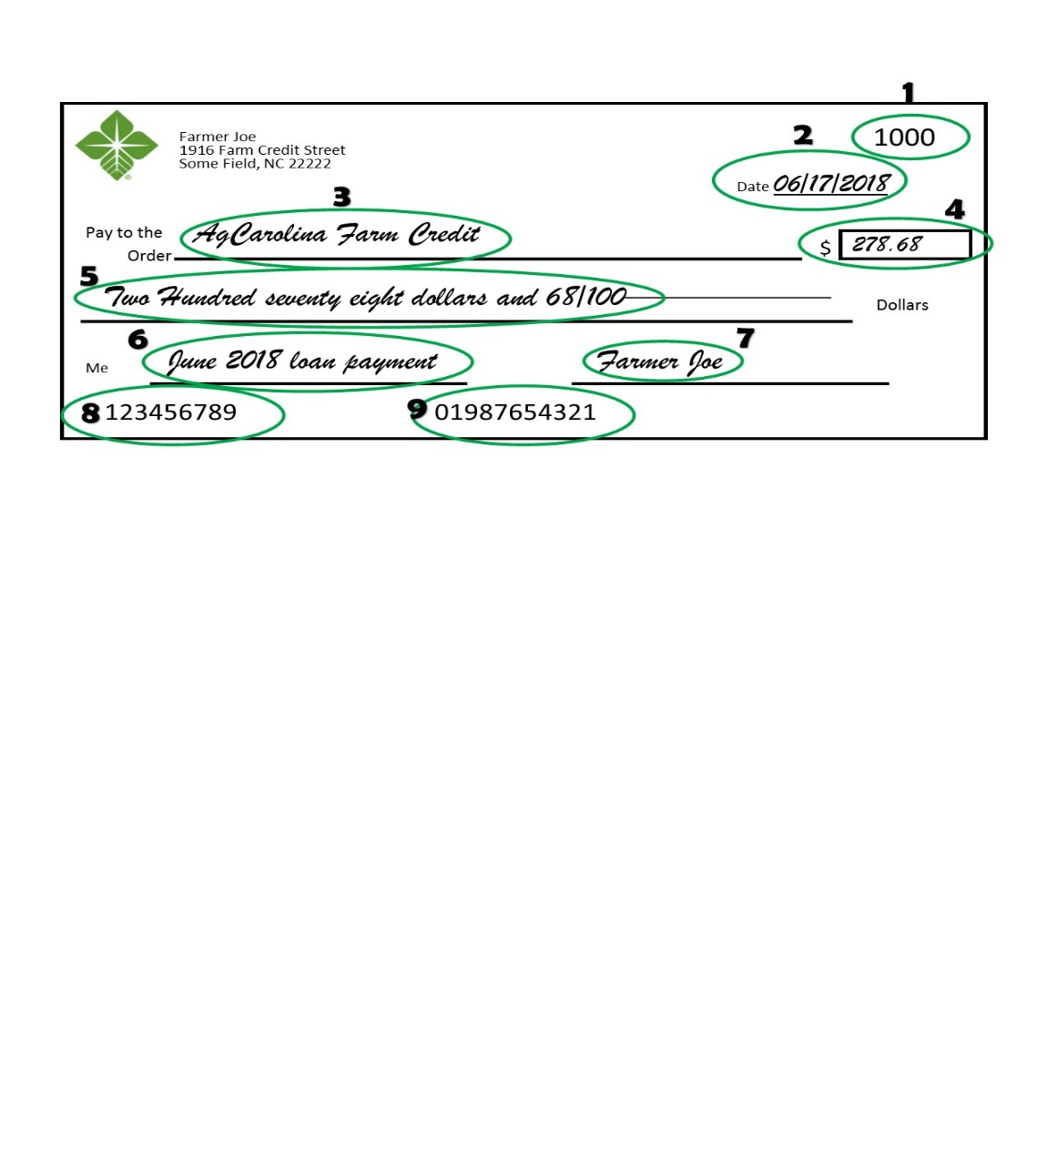
Filling out a Check
Check number
Date
Payee – who will receive the money
Numerical amount
Numerical amount written
Memo
Signature
Routing number
Account number
Activity 1
Notes:
A check is a written form to transfer money from your checking account to another person. Checks should be completed as show in the example. (Go through each item and explain it in reference to the check pictured.

Slide 8


Withdrawals and Deposits
Withdrawals remove money from your account
  Also referred to as a debit
Deposits add money to your account
  Also referred to as a credit
Notes:
The money you place into and take out of a checking account is called withdrawals and deposits. (Read bullets). On your bank statement you will usually see withdrawals referred to as debits and deposits referred to as credits. One very important thing about checking accounts is to keep up with the balance or the amount of money in the account. Do this by completing the check register to show all withdrawals and deposits. If you write a check or charge your debit card for a larger amount of money than is in the account, the bank will charge you an overdraft fee! Overdraft fees can be very costly (give an example of how much an overdraft fee might be - $30-$45)

Slide 9
CHECKING ACCOUNTS – Review Questions
What part of the check has the legal amount the check was written for?
Which account would likely have the highest interest rate: checking, savings, or money market?
What is the name of the fee charged if you write a check for an amount greater than what is in your account?
Would a deposit into your checking account increase or decrease the account balance?

Slide 10
SAVINGS ACCOUNTS
WATCH YOUR MONEY GROW
Notes:
Another frequently used financial account is the savings account. This type of account allows one of the safest way to grow your money.

Slide 11
SAVING MONEY FOR THE FUTURE
Savings account – an interest earning, deposit account at a retail bank
Saving money in a secure account creates a fund for emergency and surprise situations
  Unexpected expenses can be very costly
Savings allow for retirement, paying for college, buying a house, etc.
  If you contribute enough to savings you are paving a solid road for your future plans
Notes:
A savings account is (give definitions and descriptions above).

Slide 12

HOW MUCH SHOULD I SAVE?
Based on amount of income coming in
Goal – 10% of your paycheck goes to savings
Save up an additional amount that will equal 3 to 6 months worth of living expenses
  Pay for groceries and other daily/monthly living expenses in case you are out of work for 3-6 months
  Disability can happen to anyone, being prepared just puts you in a better position financially
Save additional funds for future plans
  Building a house
  Buying a car
Notes:
Everyone can save different amounts based on how much money you have coming in, how much you spend each month, what type of savings plan you are looking for and many other factors. Making a savings plan is the key to successfully saving money. This will give you a more exact amount of what you should save each month, it will also tell you where you can spend some leisure money for your own satisfaction. You might know that you are going to have some extra expenses a few months out of the year, and with a savings plan you can build up a good amount of money to have ready for the expensive months. (Read examples from slide above)

Slide 13

Emergency Funds
3-6 months
Be able to purchase necessities
Be able to pay in cash
Notes:
Emergency funds are an essential part of savings and can help you in a time of financial instability. You should start by saving $1000 and then pay off your debt, then start allocating more and more towards the savings account. This account should hold enough money to cover your monthly expenses for around 3-6 months depending on what you can save. This does not have to be enough to cover your wants and leisure spending money but enough to pay your bills and be able to provide for you and whoever else you are responsible for. When planning for an emergency fund, make sure you have enough to be able to pay for these necessities in cash. If you are planning on using credit to help pay during these challenging times, you will only be compiling more debt to make times even harder on yourself.

Slide 14
DECIDE ON YOUR SAVINGS GOALS
Know what your money is going towards
Find areas where you can spend less money
Write out your expenses
$8 per day
$160 per month
$2,000 per year
Notes:
Everybody should make a monthly spending report to know where they are spending money. You know that you have some fixed costs such as, housing, food, gas, utilities, health and then your leisure spending on top of that. Making a monthly expense report will show you where you could be able to save some money. For example, eating out is very popular for Americans, but this is also a very expensive habit that can cost a lot of money. If you pack your lunch every day you could save around $8 every day just on food. That would come out to around $160 each month and almost $2000 each year.

Slide 15

50/30/20 Rule
Needs
Savings
Wants
Notes:
The 50/30/20 Rule is a good way to set up your savings and spending. 50% of your income should go to your needs. This can be housing, food, health care, utilities, car payment, and any other need or fixed payment you have each month. 30% should go towards your wants, this can be shopping, eating out, any hobbies you might have, a vacation and really anything that isn’t a necessity but you desire to have or do. This 30% could also really help get rid of some of your debt. In the beginning you could pull some of the “wants” money aside and use it to lower your overall debt. 20% should go into your savings and debt account, this should be set aside for college funds, maybe a future house you are wanting to buy, an emergency fund in case times get tough and you don’t have any income at the moment. While you are in debt you should allocate about 10-15% to pay this debt off and then after you have paid most of that away start to slowly put more into savings.

Slide 16
Should I make separate accounts to put money into?
DO NOT keep your money all in one place.
Research which accounts will allow you to benefit the most from keeping money in them.
Why money market?
Notes:
You might ask yourself, should I make separate accounts to put money into?
Yes, for certain things such as a college fund, retirement, or maybe if you plan on buying a house in the future. You can make separate accounts and set aside a certain amount of money each month to go into these and start to build up interest for the future. Different accounts will allow you to do different things so be sure to research the different accounts and choose what fits your needs. A money market account will generally allow you to earn more interest than a standard savings account, while presenting no additional risk. With a money market, you can add money in when you please and still gain the benefit of a higher interest return on your money invested.

Slide 17
CREDIT & LOANS
SPEAKING THE LOAN LANGUAGE
Notes:
So far we’ve discussed saving and spending money. Now we’ll look at borrowing money when you don’t have enough to cash on hand to cover an expense. This will involve credit and loans.

Slide 18
UNDERSTANDING CREDIT
Credit Report – your history of loans, mortgages, tax liens, repayment history, etc. all listed on one report
Credit Score – a score showing your reputation as a borrower of money
  A credit score is a number based on a level of analysis to represent the creditworthiness of an individual.
Notes:
A credit report shows how much debt you have and if you have paid off your bills on time. It shows all credit accounts you have including home mortgages, credit cards, equipment dealer loans, student loans, etc. It also lists if you’ve been late on any payments, if you have went through any bankruptcies, if you haven’t paid your federal/state taxes, and if you have any judgements.
The report also lists your credit score. A credit score is a calculated number that shows lenders how likely you are to repay your debts. It represents your reputation as a borrower of money.

Slide 19
UNDERSTANDING CREDIT
Will be used anytime you get a loan to:
  Purchase a car
  Take out a loan to pay for college
  Buy a house
  Buy an ATV
  Buy land
  Get a credit card
Something everyone has
Notes:
Your credit score is something everyone will have if they have ever borrowed money. It will be used anytime you get a loan to (read list above).

Slide 20
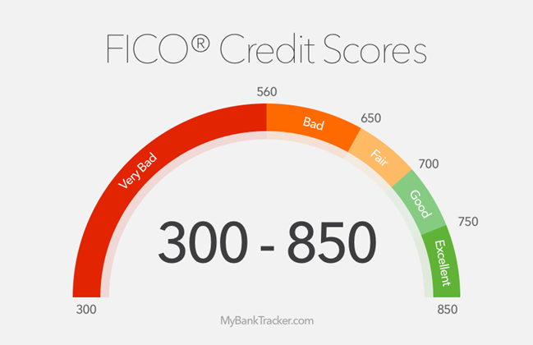
CREDIT SCORE RANGE
Notes:
Your credit score is calculated by three credit reporting agencies, Equifax, Experian, and TransUnion; these are all averaged out and come together for your final FICO score. FICO is the score that people look at most often to get the best idea about your credit history.

Slide 21
WHAT IS A CREDIT SCORE?
Where it comes from
Checking your credit score
Good credit vs. bad credit
800-850
300-579
740-799
580-669
670-739
Notes:
You are allowed one free credit report from each of those credit reporting agencies once every twelve months. It is important to occasionally check your credit report to make sure there are no fraudulent charges and that your identity has not been stolen. It is also important to maintain a good credit score. A credit score can range from 300-850, you want your score to be as high as possible. Typically a good score is above 700. A score above 800 is exceptional, not many people will get over 800.

Slide 22
WHAT AFFECTS YOUR CREDIT SCORE?
Notes:
Many things can affect your credit score, such as your payment history which accounts for 35% of your score; this shows how well and timely you pay off your balances on credit cards and any other debts you have that need to be paid. Outstanding Credit/limit, which is 30% of your score; this shows how much you are allowed to use compared to how much you actually use. Normally you want to keep this around 10% for each Credit Card, if you go above this and leave the balance high on it from month to month this can hurt your score. Length of relationship, this is 15% of your score and shows how long you have had credit, the longer you have a good history the more it will help your score. If you can show that over time you can consistently pay off debt your score will be higher. Types of credit is 10% of your score, this talks about what kind of credit you are using. This means having a diversity of credit types, like a car loan, credit card, student loan, mortgage and more. Showing that you can pay off a wide variety of loans can really help boost your score. New credit finishes the score off at the last 10%, this shows how many new credit accounts you have opened in the last 12 months. This also takes into consideration each time someone is pulling your credit report. If it shows that your report has been pulled a lot in the past year, this can indicate a greater risk. It can hurt your score to pull a credit report a lot and show that you are trying to get money from a lot of different sources.

Slide 23
BENEFITS OF HAVING A GOOD CREDIT SCORE
Loan Approval
Saving money
Interest rates
Eligible for lower auto and homeowner insurance premiums
Notes:
There are a bunch of benefits to having a good credit score, one being that it is easier to get accepted for a loan. With a high score it shows lenders that you have been responsible with the money lent to you and that you have paid it back on time. Another big benefit that will save you a lot of money is you will be given lower interest rates on loans you receive. This will save you money in the long run by not having to pay a high interest rate. You will also be eligible for lower auto and homeowner insurance premiums. These are both generally expensive but with a good credit score, you will be able to save thousands of dollars each year. It can also eliminate the requirement of paying a deposit when signing up for utilities like power.

Slide 24
TOP 3 C’S OF CREDIT
CAPACITY
  Can you repay the money that is lent to you?
  What income do you have?
CHARACTER
  Have you been a good customer at other banks?
  Do you have good repayment history?
COLLATERAL
  What can we hold to get you to repay?
  Lien = statement of ownership rights on a piece of collateral
Notes:
In addition to your credit score, lenders often look at some top Cs of credit including Capacity, Character, and Collateral. (Go over each bullet and sub-bullet)

Slide 25

WHAT IS A LOAN?
A form of debt
Money borrowed from a lender, with a promise to repay the money + interest
Lenders
  Bank
  Credit Union
  Farm Credit
Notes:
Now that we’ve covered credit and talked about the things listed on your credit report, you may be wondering What is a Loan?
Loans are a form of debt incurred by an individual or entity referred to as a borrower. A borrower borrows a sum of money as an advancement, and in return repays the lender the advancement with additional charges, interest, fees, or other conditions applicable. Loans may be for a specific, one-time amount, or as an open ended line of credit, with a specific limit.
Loans occur when a sum of money or credit is borrowed from lending institutions, such as:
banks, credit unions, or Farm Credit, and is expected to be paid back usually with additional interest.

Slide 26

SPEAKING THE LOAN LANGUAGE
Borrower
Lender
Collateral
Interest
  Annual Percentage Rate
Notes:
Let’s go over some basic loan terminology commonly used when regarding loans
A borrower is a person or entity that attains finances from another individual or business, for a specific amount of time with the condition to pay it back
A lender is an individual, entity, of financial institute that makes money available to another person or business with the expectation of repayment. Repayments will include interest and fees
Collateral is an asset a lender accepts as security for a loan. In the event that a loan cannot be repaid by a borrower, collateral is used as a form of payment, as well as an incentive for borrowers to repay their debts.
Interest is the charge or cost of borrowing money, and is usually expressed by an annual percentage rate (APR).
The term APR refers to the rate of interest charged to borrowers and paid to lenders.

Slide 27
SPEAKING THE LOAN LANGUAGE
LOAN AMOUNT
  Larger loan amount = larger monthly payment
DOWN PAYMENT
  15-25% for land
  5+% on average for homes
FEES
  Charges in addition to the purchase price of the things you buy
  Cover costs that the lender has in providing money to you for your purchases
TERM
  Length of time you have to repay the loan
  Longer term = lower monthly payment BUT larger total interest charges over the full life of the loan
INTEREST RATE
  Percentage amount added onto each payment
  Higher rate = greater total interest charge over the full life of the loan
Notes:
(Go through each bullet)
Loan amount – total amount of money borrowed
Down payment – any cash you pay towards the purchase in addition to the amount of the loan. Sometimes a down payment is required because the lender will only lend you part of the total purchase amount. (give the land loan example listed)
Fees – (give description listed)
Term - (give description listed)
Interest rate – the lender’s cost to you for allowing you to borrower their money. (give examples above)

Slide 28
INTEREST RATES
Interest rates are the amount a lender charges for the use of borrowing money or assets
  Fixed Rates
  Variable Rates
  Adjustable Rate
Notes:
Lenders offer a variety of fixed, variable, and adjustable rates, depending on the type of loan a customer has.
A fixed interest rate is an interest rate that stays the same over the span of a loan,
or for a portion depending on the AGREED ARRANGMENT
Variable-rate loans have an interest rate that can vary up or down, during the term of A loan. The rate being charged on variable rate loans is tied with a particular “index”. These indexes allow you, the borrower, to judge for yourself, what potential movement there may be in the rate.
Adjustable Rate Mortgages (ARMs) are a special kind of product, that combines features of both fixed and variable interest rate products. ADJUSTABLE RATE MORTGAGES OR ARM’s,
fix the interest rate for a specific period of time-- one-year, three-year or five-year. The interest rate is indexed to US Treasury securities. As US Treasury rates move, the rate on the ARM may ALSO MOVE, after the initial fixed period.
When obtaining a loan it is important to ask whether there are an pre-payment penalties for the loan. A pre-payment penalty is an additional fee that some lenders charge you for paying off your loan early.

Slide 29
INTEREST
Interest
A percentage of a loan to be paid to the lender for the privilege of borrowing money.
Simple Interest
Interest on the principal amount borrowed.
Compound Interest
Interest on the principal and interest accrued on the amount borrowed.
Activity 6
Notes:
There are three different types of interest: (give examples and definitions above)

Slide 30


LOAN TYPES
Secured
Unsecured
Commercial
Agri-Consumer loans
Notes:
Now let’s discuss some of the different loan forms that you’ll commonly see when obtaining a loan:
Secured loans require an asset’s collateral for the loan. This collateral is used as a payment to a lender should the loan be unpaid by the borrower. This usually results in lower interest rates for the borrower. Some common examples of secured loans are mortgage, vehicle, and secured credit cards etc.
Unsecured loans have NO collateral, just an agreement to repay the loan. Unsecured loans are issued based on the borrower’s creditworthiness. For this reason, unsecured loans may have higher interest rates, as well as additional fees to pay. Some examples of unsecured loans are credit cards, student loans, and other personal lines of credit.
Commercial loans are financing arrangements between a business and financial institution. Commercial loans are usually used to purchase major capital and cover operational costs. Companies generally provide financial statements to prove their repayment ability.
Agri-Consumer loans are smaller farm loans directed specifically to farmers and other agriculture expenditures. AGRI-Consumer loans enable farmers to secure equipment, plant, harvest, marketing, and otherwise diversify their farms or agriculture ventures.
Before applying for any loan, carefully evaluate your personal finances. Loan terms are agreed upon by all parties involved before money is advanced.

Slide 31


FARM LOANS
Equipment
Operating & Livestock
Farm Improvements
Notes:
Farm Credit offers an array of loans that support farm, land, and home financing.
FARM LOANS at Farm Credit may be used for equipment, operating & livestock, and farm improvements.
Equipment loans offered at FARM CREDIT may be termed up to 5-7 years. Equipment loans may be applied to items such as horse trailers, tractors, ag trucks etc.
Livestock loans offered at Farm Credit may be termed up to 4 years depending on the animal. Some cattle and livestock THAT MAY be financed include cows, goats, poultry, horses, etc.
For borrowers interested in farm improvements, Farm Credit offers the option of a short term (up to 7 years), or long term (up to 15years) loan. Farm improvement loans may be used for upgrading buildings and structures intended for agriculture, and other maintenance expenses.

Slide 32

LAND LOANS
Acreage
Farm Land
Country Homes
Notes:
As a farmer or rancher, whether you are just starting out or have many years of experience, there are times when you need to borrow money to start, expand, sustain, or make changes to your business.
Farm Credit offers loans to help build your dream home, growing space, or operational expansion.
Land loans at Farm Credit can be categorized by farming and building intent. Borrowers seeking land financing with a farming intent have term loan term options of 1-20 years. Land loans with a building intent share a similar lending total with shorter term lengths. Building intent loans may be termed up to 10 years.

Slide 33

HOME LOANS
No max acreage limitation
Competitively Priced
No max loan amount
Government Loan Flexibility
Manufactured housing eligible
Notes:
Farm Credit understands that the process of purchasing or building a new home can often be overwhelming. Specialists at Farm Credit help buyers to understand the home buying process, and offer a wide selection of purchasing options. Farm Credit services purchasing, building, and refinancing homes. Home loans may be financed up to 30 years. We offer a one-time closing for home construction loans, as well as a locked in interest rate. These features help the borrower save money on closing and some building costs.

Slide 34
IMPORTANT LOAN REMINDERS
Make your monthly payment
If you are able, make higher payments towards the principal amount to reduce the amount of interest that would accumulate.
  Reduces the overall cost of the loan
Notes:
Loans can be a tricky but very useful tool during your lifetime. The most important things to remember are: (Go over information above)

Slide 35
CREDIT & LOANS – Review Questions
What are the credit score ranges? What is considered a good credit score?
What is the advantage of making higher monthly payments?
What is the difference between simple and compound interest?
For a savings account, would you want your interest compounded more or less often?

Slide 36
RETIREMENT & INVESTING
PLANNING FOR THE FUTURE
Notes:
In this next section we will dive into planning for the future with insurance, retirement, and investing.

Slide 37
WHY DO I NEED INSURANCE OR A RETIREMENT ACCOUNT WHEN I’M YOUNG AND HEALTHY?
BLOCKING THE COST OF RISK
Health
Auto
Life
Disability
Long-term care
Property
Notes:
You might ask yourself, why do I need insurance or a retirement account when I’m young and healthy? The answer is, to block the cost of risks in your life. Risks can come in the form of health problems, auto accidents, disability, property damage due to a hurricane, etc. With so many risks, insurance offers a financial safety net to cover the costs associated with these risks.
Your retirement, on the other hand allows you to plan for life once you complete your career. Although that may seem years away, it is important to start planning now.

Slide 38


MINDSET FOR STARTING YOUNG
Visualize what you want
It’s not your money, it belongs to your future
Don’t take too many risks
Notes:
The first step to starting young is to visualize what you want. Picture what you want your retirement lifestyle to be like then plan around that. It is important to not touch the money and understand that it is not your money right now, it is for the future you. Don’t take too many risks with it. Buy and hold for the long term.

Slide 39

RETIREMENT PLANS
Planning which helps an individual be financially stable after they retire
There are numerous types of retirement plans
Notes:
Now to transition to Retirement plans. Many people when asked what their retirement will look like, they mention vacation and enjoying life. This sounds great but where will the funds come from to finance these trips? This is where the role of retirement plans come into play. Retirement plans involve planning which helps an individual be financially stable after they retire. There are numerous retirement plans, including 401Ks and IRAs.

Slide 40

Retirement
Based on your current age, it is estimated that the following amounts will be needed at the age of 65 to retire:
  25 year old: $3-4 million
  35 year old: $2-3 million
  45 year old: $1-2 million
Save 10-15% of your annual income for retirement.
One million dollars today will not be worth one million dollars in 20 years due to inflation & the future value of the US dollar.
Notes:
Before you choose a retirement plan, it is important to figure out where to begin and how much you should save. (go over bullet 1)
The goal that most financial advisors suggest is to (go over second bullet)
(go over third bullet)

Slide 41
WHERE TO BEGIN
Know how much money you have available to use
Understand how much risk you are willing to take
Diversify your portfolio
Pick a place
Never invest more than you can afford to lose
Notes:
There are 5 simple steps when looking at where to begin when retirement and investing. First off is to know how much money you have for investing. One popular rule of thumb is the “100 minus age” rule, which means you take 100 and subtract your age from that. The resulting number is the percentage you should allocate to stocks. For example if you are 30 then 70% of your assets should be allocated to stocks. This is just a general rule and others may find it better to use less or more. 2nd is to understand how much of a risk you are willing to take. There are some funds that are low risk, low reward and others high risk, high reward. It all comes down to what’s best for you. 3rd is to diversify your portfolio. You do not want all your eggs in one basket. Make sure you are diversified. Being diversified means to make sure that you have stocks that are in various industries. Sometimes the medical stocks preform well or sometimes banking stocks so it is important to not have all your stocks in one industry. 4th is to pick a brokerage account that best fits you or employer sponsored accounts such as 401 (k). 5th is to never invest more than you can afford to lose. There’s a chance you may lose money so for safety reason it is best to invest an amount that you can afford to lose.

Slide 42
SAVING FOR RETIREMENT IS EASIER THE EARLIER YOU START SAVING
Retirement amount
  Depends on the lifestyle you want to live in retirement
When to retire?
  Retiring earlier = shorter period of time to build funds
How long will retirement funds last?
  25 years or longer
401K/403B plans
  Tax friendly
  Employer matched
IRAs – Traditional and Roth
Notes:
(Go over items listed)

Slide 43

401 (K) PLANS
Employer sponsored account that comes out of your paycheck
Employers can match up to a certain percentage which is equivalent to free money.
Withdrawing the funds early can result in a penalty
Notes:
The first type of retirement plan which is one of the more popular is the 401(k) plan. This is a workplace retirement account that’s offered as an employee benefit. By using this it could help eliminate the amount of income you pay taxes on. These are great options as many employers match your contributions up to a certain percentage. For example, some companies can match your 401K investment up to 6%. In other words, if you invest 6% of your salary into your 401K account, the company will also invest 6% into your account. There are a few negatives such as withdrawing EARLY. If you withdraw funds before the age 59 ½ then you are subject to a 10% penalty. There are also contribution limits, as of 2020 the limit was set to $19,500. Overall this is a great plan with low risk.

Slide 44
INDIVIDUAL RETIREMENT ACCOUNTS (IRAs)
Make investment decisions yourself
Grow quickly
You can buy and sell investments in stocks, bonds and mutual funds, and any other type of investment
Notes:
If your employer does not offer a retirement plan or if you have already maxed out your 401K then you may want to invest in an Individual Retirement Account, better known as an IRA. With an IRA you can contribute up to a specified amount as determined by the IRS. If you are age 50 or older, you are able to contribute an additional amount as part of the “catch up” provision. If you select traditional IRA, your contributions will be tax-deductible in the year in which they are made. An IRA has the same stipulations as a 401K when it comes to withdrawing money before 59 ½ which is a 10% penalty.

Slide 45
TYPES OF IRAs
Roth
SEP
Great if you’re self-employed and have no employees.
Contributions are made with after-tax dollars
Withdraw money before retirement with no penalty
Cash grows extremely fast
Deduct these contributions from your taxable income.
Max annual contribution limits of $57,000 or 25% of income- whichever is less
Traditional IRA
Deduct contributions now and pay taxes on withdrawals later
Upfront tax advantage
No income eligibility restrictions
Notes:
There are several different types of IRAs.
A ROTH IRA is a great start with retirement plans. Contributions to a ROTH IRA are taxed beforehand, withdrawals are never taxed and it grows at a rapid rate. It is great place for when you’re just starting out and have extra money you want to use. You can invest in an IRA and ROTH IRA but your total contributions to both can not exceed the specified limit for the year.
Simplified Employee Pension or SEP IRAs allow you to contribute a portion of your income to your own retirement account. These accounts are great if you’re self-employed and have no employees. The max annual contribution limits are significantly higher than the other accounts as you can contribute up to $57,000 or 25% of your income in 2020, whichever is less.
A Traditional IRA allows you to deduct contributions on your current taxes and not have to pay taxes until you withdraw funds later in retirement. These accounts do not have any income eligibility restrictions. They also offer an upfront tax advantage.

Slide 46
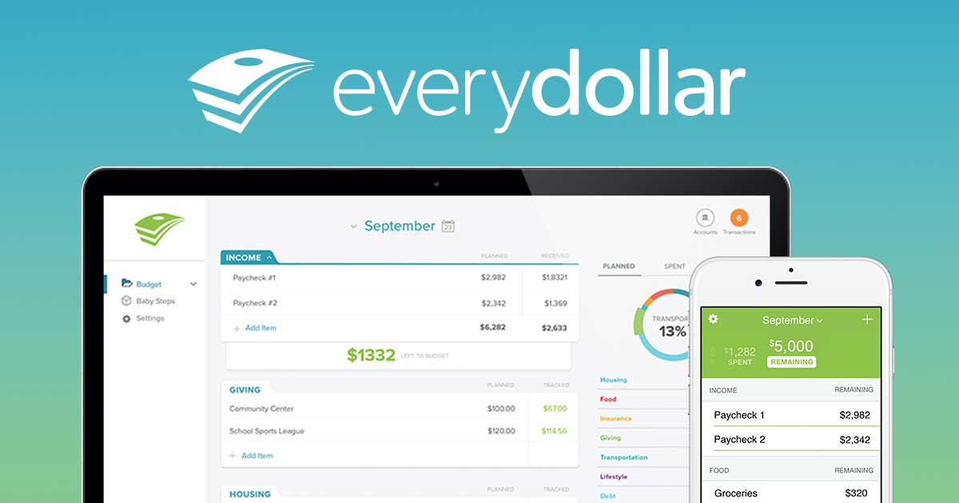
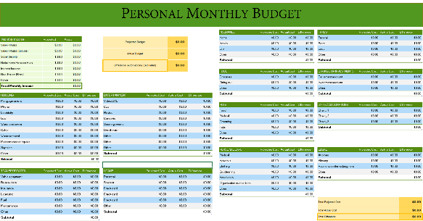

TOOLS THAT MAY HELP
Dave Ramsey “Every dollar” app
Basic spreadsheet
Invest 10-15% of household income to retirement plan
Notes:
These tools may assist you in budgeting your money for your retirement and investing plan. Dave Ramsey offers an app that helps you keep track of your money usage so you can see where every dollar goes to throughout the month. A basic spreadsheet can also be helpful for creating a budget to set aside money for your retirement planning. A good tip is to aim to invest 10-15% of your household income to your retirement plan. If you do that when it comes time for retirement you will be ready to do whatever you choose to do to enjoy your time.

Slide 47

INVESTING
Investing: Expend money with the expectation to achieve profit.
The more you know the more successful you will be!!
Putting your money in an account that draws interest from different companies
  More risk equals more potential earnings on your account
  Less risk equals less potential earnings on your account
401K, IRA, etc.
  If your budget allows, always max out your employer matched contributions
Notes:
In a financial sense, investing is when an individual commits money to a financial asset, or security, such as a bond or stock, in hopes of receiving more money in the future. Investing can be seen as risky and overwhelming but with these basic understandings, hopefully investing will begin to take shape and you can develop a clearer understanding.
(read through bullets listed)

Slide 48

INVESTING
Your age = The percent of your portfolio in “safer” investments
  Bonds, bond mutual funds, CDs, etc.
100 – Your Age = The percent of portfolio in “riskier” investments
  Stocks, stock mutual fund, real estate
Based on this rule, you should have riskier investments earlier in life and safer ones later in life.
Notes:
There is one quick way to look at your investment strategy. Your age should equal the percent of your portfolio that is held in safer investments like bonds, bond mutual funds, CDs, etc. If you take 100 minus your age, that should equal the percent of your portfolio that you should place in riskier investments like stocks, stock mutual funds, real estate, etc. Based on this rule, you should have riskier investments earlier in life and safer ones later in life.

Slide 49

INVESTING
Risk averse refers to a person who prefers lower returns with known risks rather than higher returns with unknown risks.
  What is your risk tendency?
Activity 7
Notes:
In the world of investing, riskier investments earn a greater return and less risky investments earn a lower return. When talking with a financial advisor you might hear the term risk averse. This refers to a person who prefers lower returns with known risks rather than higher returns with unknown risks. It is important to ask yourself, what is my risk tendency?

Slide 50

TIME VALUE OF MONEY
Time value of money: the concept that money available today is worth more than the future identical sum because of investment potential.
The formula for time value of money is: Future value = present value (1+(i/n)) ^{(n * t)}
  i = Interest rate
  n = Number of compounded periods
  t = Time
Activity 8
Notes:
(use definition and example given)
Your money grows because of compounding interest. Now let’s look at an example of this money growth.

Slide 51
PLANT YOUR MONEY AND WATCH IT GROW!!
Lindsey
Jackson
Starts saving/investing at age 19
Stops saving/investing at age 27
Puts $2,000 in the account from her paycheck each year
If her account earns an annual average of 10% interest
At age 65 her account will have $1,035,148
Starts saving/investing at age 27
Stops saving/investing at age 65
Puts $2,000 in the account from his paycheck each year
If his account earns an annual average of 10% interest
At age 65 his account will have $883,185
Notes:
This example shows the importance of starting to save earlier in life. It highlights the importance of the time value of money and compounding interest.
As shown (go through the scenarios listed)
Lindsey invests one-fifth the dollars, but has 25% more to show in the end
Returns are hypothetical and are not meant to imply the future performance of any investment, because all investments and rates do change over time.

Slide 52
RETIREMENT & INVESTING – Review Questions
How much money would a 25 year old need to retire?
What is an advantage of starting to save for retirement at an earlier age?
What does it mean to be risk averse?
What type of account can return you the most interest?

Slide 53
CAREER PLANNING & TAXES
THINGS TO CONSIDER
Notes:
Now that we’ve discussed what to do with the money you earn, let’s look into planning a career to help you earn that money and how taxes come into play.

Slide 54
CAREER PLANNING
When choosing a career, you should consider: salary, opportunities, time-off, and benefits
Gross salary: Stated salary
Net salary: The amount you take home after all deductions and withholdings have been made.
Notes:
(Go over bullets listed and elaborate on Gross and Net salary)

Slide 55
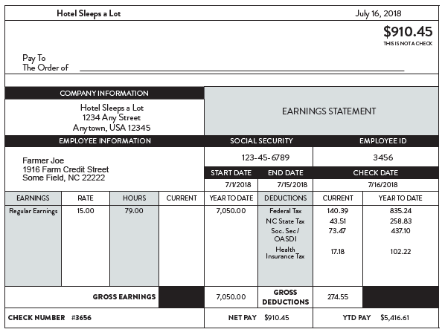
UNDERSTANDING YOUR PAY STUB
Notes:
A pay stub is a form, produced by your employer, that breaks down your hours worked per pay period, the gross amount of money you earned, all taxes, healthcare costs, and other funds that were deducted from your gross earnings, and your net pay, or the amount of money that you will receive when you cash your paycheck.
(Explain the following components of the paystub: Gross income, net income, federal income tax, state income tax, social security, medicare, year to date savings.
Also give an explanation of how companies determine how much to take of your paycheck for taxes, i.e. the W-4)

Slide 56

TAXES
No matter how much we dislike them, we all have to pay them!!
Property tax
Sales tax
Income tax: State and federal
2018 Federal Income Tax Brackets
% of Income | Single Filers | Married Filers
10% | $0-$9,525 | $0-$19,050
12% | $9,526-$38,700 | $19,051-$77,400
22% | $38,701-$82,500 | $77,401-$165,000
24% | $82,501-$157,750 | $165,001-315,000
32% | $157,751-$200,000 | $315,001-$400,000
35% | $200,001-$500,000 | $400,001-600,000
37% | $500,000 or more | $600,000 or more
Activity 5
Notes:
(Discuss the purpose of taxes.) Taxes are fees so we can enjoy amenities provided by the government.

Slide 57
SPOILER ALERT!!!
TAXES CAN BE REDUCED
  Pre-tax retirement/investment plans are not taxed until they are withdrawn
  Roth retirement/investment plans are funded with after-tax dollars, but if certain requirements are met, withdrawals are federal income tax free
  Watch out for penalties
    Making certain withdrawals too early
Notes:
Although taxes may seem like a necessary evil, there are ways you can reduce the amount of taxes you pay each year. Taxes can be reduced by using pre-tax retirement plans, like the IRAs we discussed previously. Traditional IRAs are not taxed until funds are withdrawn when you retire. Roth IRA plans are funded with after-tax dollars, but if certain requirements are met, withdrawals are federal tax income free. Each year, you will have to complete your state and federal tax returns by April 15th. If you have an accountant prepare your tax returns, it is always important to ask them about ways to reduce your taxes. You should also check with your financial advisor about any penalties for withdrawing money early from your investments and retirement accounts.

Slide 58
CAREER PLANNING & TAXES – Review Questions
What is the difference in gross and net income?
What is an example of a tax withholding?
Name one type of benefit your employer may provide to you.

Slide 59
BUDGETING
PUTTING MATH TO GOOD USE
Notes:
In this section we discuss the basics of budgeting and guide you through a simple percentage breakdown of your monthly income. We will also look at how to get started and some various budgeting tools you may find helpful to stay organized.

Slide 60
WHAT IS A BUDGET ANYWAY?
Budget: Record of income and expenses for a given period of time.
Measuring the flow of money, what’s going in and what’s coming out
  Income and expenses
Track the flow of money so you can control where your money goes
Types of budgets: Paper budgets, Excel spreadsheets, the envelope system, Mobile apps
How does it work in real life?
Activity 3 and 4
Notes:
So what is a budget anyway?
(read definition and bullets from the slide)

Slide 61

BUDGETING EQUALS LESS STRESS INTRODUCTION TO BUDGETING
Budgeting breakdown
Not one size fits all
Monetizing your expenses
Notes:
Budgeting is a tool that enables financial planning and control over resources, those resources include time and money. The budget process involves planning for future profitability. A budget assists in balancing your income with your expenses.
By prioritizing your monthly income based on a budget break down best suited for your needs, it will enable you to reach your personal and financial goals. The most common budget breakdown is denoted as 50/20/30; allocating 50% of your monthly income for needs, 20% to paying off debts and establishing a savings, and 30% for discretionary spending. This breakdown of 50/20/30 is an on-average budgeting system which may be inadequate for your own financial goals.
When budgeting, there is not a “one size fits all” method. According to John Csiszar, a budget that works well for you is one that allows you to comfortably pay all your bills, save for retirement and enjoy yourself.
Monitoring your expenses throughout the month holds you accountable for your finances. By tracking your purchases, you are able to see exactly how your money is being allocated each month which will lead to better and more profitable decision making. On the other hand, not tracking spending can often result in the accrual of debt.

Slide 62

BUDGETING IN REAL LIFE
INCOME
  Paycheck
  Rent Income
  Interest Earned
  Investment Income
EXPENSES
  Things you have to pay – rent, mortgage, electric bill, car insurance, groceries, etc.
  Optional items you pay for – Starbucks coffee, Netflix, Chick-fil-A, new shirt from Belk, 4-wheeler, etc.
Notes:
Budgeting can be broken down to income and expenses. Income is just as it says, all money coming into your bank account. This can include your paycheck, rental income, interest earned, and investment income.
Expenses include everything that you spend your money on. Basically this will be things you have to pay like rent, mortgage, electric bill, car insurance, groceries, etc. It also includes those optional “want” items like Starbucks coffee, Netflix, Chick-fil-A, a new shirt from the mall, a 4-wheeler, etc.

Slide 63
BUDGETING IN REAL LIFE
INCOME – EXPENSES = SURPLUS or DEFICIT
Surplus
  Extra money left over for saving or investing
  Extra money left over for some fun things in life
Deficit
  Spending more money than you are making
  If this goes on for a few years it can sink your financial boat
Notes:
By taking your income and subtracting your expenses, you will end up with a surplus or a deficit.
A surplus means you will have extra money leftover for saving, investing, or some fun things in life.
A deficit means you are spending more money than your are making. If this goes on for too long, it can sink your financial boat very quickly!
This is why it is important to come up with a plan ahead, also known as a budget.

Slide 64

PERCENTAGE OF INCOME BREAKDOWN
50%
SAVINGS
Emergency Fund
Essential Expenses
Retirement Savings
NEEDS
Housing Cost
Groceries
Utilities
Healthcare Costs
Transportation
DEBT
Student Loans
Credit Card
Other
20%-30%
DISCRETIONARY SPENDING
Entertainment
Vacations
Technology
20% - 30%
Notes:
When prioritizing your expenses, you may want to categorize your budget into savings and debt, needs, and discretionary spending. Dave Ramsey suggests the 50/20/30 breaking down your monthly income into percentages.
First, allocate 50% of your monthly income for your needs. Of that 50 %, on average…
25-30% should be used to pay for your housing
10-15% should be utilized for groceries
5-10% should be put toward the cost of utilities
5-10% should be allocated for healthcare costs
And 10-15% should go towards paying for your mode of transportation.
Once you allocated for your monthly expenses, then you should portion about 20 to 30% of your income towards getting out of debt and building your savings.
First, you should establish an emergency fund ($1,000). This should cover any unexpected expenses that may arise.
Once you have established an emergency fund as a safety net, then you should begin paying off any incurred debt, other than housing and transportation costs. This includes student loans, credit cards, and any other outstanding balances that may hinder your financial flexibility.
After you have paid most of your debts, it is a good idea to establish a fund that allocates money for 3 to 6 months of essential expenses. Once you have established a healthy savings account, you may want to consider allocating 10 to 15% of your savings for a retirement account.
Your monthly allocation for discretionary spending may vary from month to month depending on your circumstances. You may save more and spend less on yourself while planning for a vacation. You may treat yourself at the end of a long month at work. Or even repay yourself. Either way, on average, you should allocate about 20 to 30% of your monthly income for discretionary spending.

Slide 65
STEPS TO CREATING A BUDGET
Step 1
Step 2
Step 3
Step 4
Compare your spending to your budget
Set personal and financial goals for yourself
Assess your situation
Write down your total monthly income
Live within your means
Write down your monthly expenses
Review your progress and revise your budget if needed.
Track your expenses throughout the month
Notes:
When creating a budget you want to begin by recording your total monthly income. A good rule of thumb for those trying to build their savings is to subtract your monthly savings allocations before you begin your budget. This eliminates the method of only saving what is left over in your current budget.
You should list all of your expenses for the month, making sure to include any fees or insurance that may apply. From this, you should subtract your total expenses form your monthly income to see the bottom line of your budget. If you are left with a positive number, you’re living within your means. If your sum is negative, that means your expenses are higher than your income which could result in the accrual of debt. This is referred to as living out of your means. If you are over budget try cutting back your allocation for discretionary spending first before decreases the amount of money allotted for your debt and savings.
In order to stay on track with your budget, continuously update your incurred expenses throughout the month. There a many different tools and apps designed to track your spending as well.

Slide 66
BUDGET SPENDING SUGGESTIONS
Notes:
(Discuss the different spending suggestions.)

Slide 67

MANAGING YOUR BUDGET
Increase income
  Afterschool/weekend job
  Babysitting
  Helping neighbors with chores
Reduce spending
  Coupons
  Smart shopping
  Avoid impulse purchases
  Eat at home
Notes:
Once you have planned out your budget it is important to manage and revisit it very often. Always check your progress as you go throughout each month. Don’t wait until the end of the month. If you are not bringing in enough income, consider ways to increase your income. (go through list of examples above). You should also think of ways to reduce your spending. (go through list of examples above)

Slide 68

TOOLS TO HELP YOU BUDGET
Dave Ramsey’s EveryDollar Budget App
Spreadsheet/Downloadable templates
Personal Monthly Budget Sheet
Dave Ramsey’s Budgeting Forms
Notes:
Numerous tools can be found online that are designed to make budgeting easy and efficient.
Dave Ramsey’s EveryDollar is a budgeting app that tracks your spending and form that creates a personalized monthly budget. Essentially this app tracks where every dollar goes in order to formulate a conservative monthly spending plan.
For those who wish to utilize a hard copy, Dave Ramsey also provides a printable budgeting form. This form provides the basics of monthly budgeting. However, user calculations are necessary if you chose to use this form.
In addition to these tools, there are numerous downloadable and printable spreadsheets available online. It is important when selecting a tool to use, that you select the one that is best suited for your needs and is easiest to utilize.

Slide 69
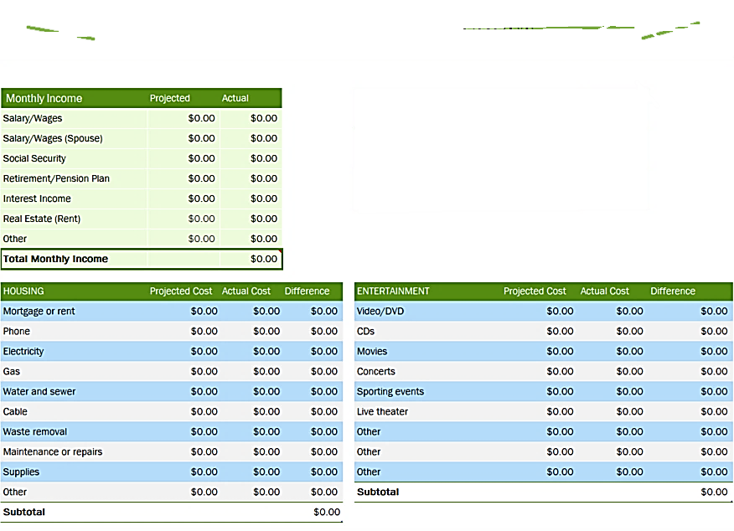
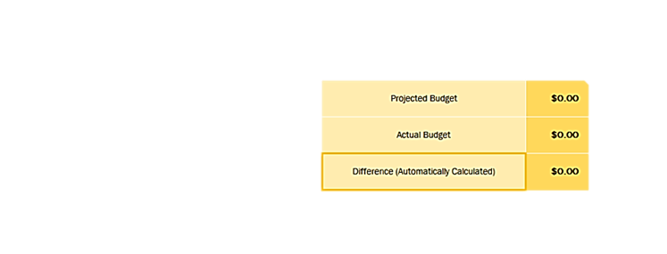
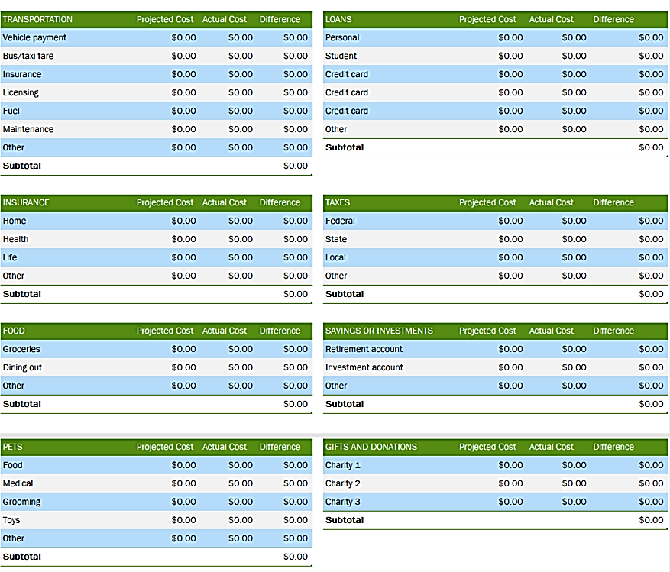
Personal Monthly Budget
Notes:
Here is an example of a personal monthly budget.
This form specifically allows you to create a projected monthly budget prior to the start of the month. During the month, this sheet breaks down the average monthly expenses of items from electricity and automobile insurance to personal care and pets.

Slide 70
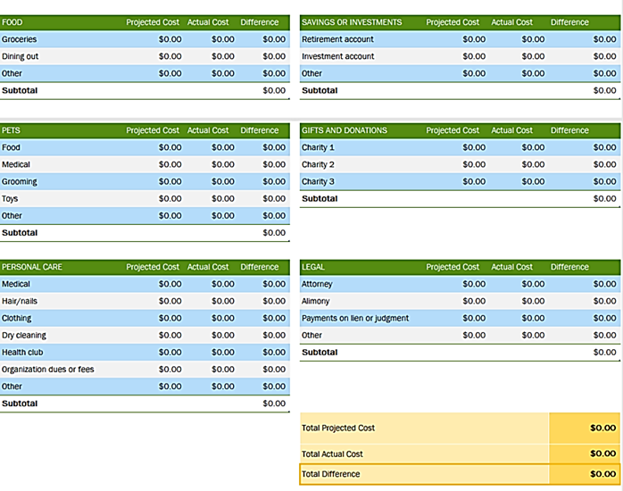
Notes:
By establishing the difference between your projected budget and actual budget, it determines the flexibility of your budget.

Slide 71
BUDGETING – Review Questions
What is a budget?
How can you track your spending?
What percentage of your income should you set aside for your savings?
What are two ways that you can increase your cash flow?

Slide 72
FINANCIAL GOAL SETTING
THE SMARTY WAY
Notes:
Now you might be wondering, how do I make my finances fit into my life goals?? The answer is by not just setting life goals, but by also setting financial goals using the SMARTY way.

Slide 73
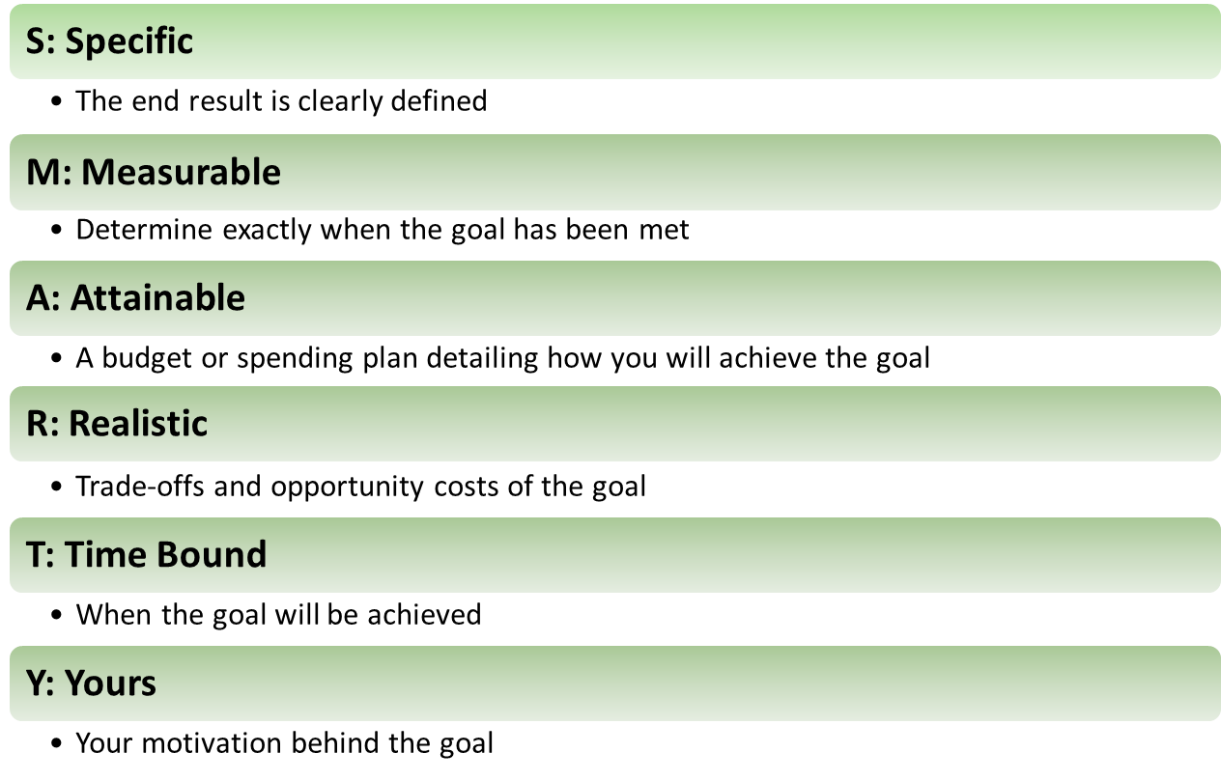
GOAL SETTING MADE EASY
Financial goal setting is a significant factor to achieving long term financial goals.
Financial goals should be SMARTY
Notes:
(Go over bullets and definitions listed above) Specific – definition and detail, Measurable – track your progress, Attainable – nothing unrealistic, Relevant – based on your needs and values, Timely – Set a deadline, Yours – your motivation behind the goal

Slide 74

Financial Goal Setting
Example of a financial SMARTY Goal: I will pay off the amount I owe on my car loan in 2019 by paying an extra $100 per week. I will pay off this loan amount because I want to be debt free before buying a house.
Activity 2
Notes:
(Go over example listed)

Slide 75
TAKE NOTES
ALWAYS WRITE DOWN YOUR GOALS!
  Short term
  Long term
Goals are the foundation of your financial plan
Goals are the starting point for saving and investing
Notes:
It is always important to actually write down your goals. People who write down their goals have been shown to be more likely to achieve them. Keep in mind that there are two types of goals, short term and long term. Short term goals include things you plan to accomplish within a year or less. Long term goals will be carried out in the future. (Go over last two bullets listed above)

Slide 76
FINANCIAL GOAL SETTING – Review Questions
Why would a goal need to be time bound?
What is an opportunity cost?
What is a goal?

Slide 77
RECORD KEEPING
TRACKING YOUR PROGRESS
Notes:
If you end up owning your own business or becoming a farmer, record keeping will be a very important skill you will need to learn. Record keeping can also be important for your personal finances. In this section we will discuss the benefits of personal and business record keeping. We will also explore various tools and programs offered by Farm Credit in order to establish a system for mindful decision making. To begin we will look at the pros of record keeping.

Slide 78


GROWING YOUR RECORDS
Leads to better decision making
Determine profitable productions methods
Establish a system that meets your needs and wants
INCOME STATEMENT
BALANCESHEET
ANNUAL
PRODUCTION
Notes:
Record keeping leads to better decision making. Through the keeping of strong agricultural, personal and business related records, you are able to determine which productions methods are most profitable. There is not just one right way to establish an effective and efficient record system. Some individuals prefer utilizing online tools for simplicity. Others benefit from creating a hard copy system of filed papers rather than using technology. There are pros and cons to each method and either way you do it will benefit your ability to make profitable decisions throughout the year.

Slide 79
Strong record-keeping is indicative of strong management
Creates beneficial budgeting strategies
Establishes personal organization with a central location for annual records
Strong record-keeping is indicative of strong management
The Importance of Record Keeping
Notes:
In an interview with a Farm Credit, commercial-ag loan officer, he stated:
Strong record-keeping is indicative of strong management. It enables you to find opportunities to diversify your operation. He says from a lenders perspective, solid farm records are vital to an accurate lending decision.
And when it comes time to take out a loan, record keeping is a valuable tool. Your well-kept records will enable the lender to give you the best possible financing terms based on your financial and farm management ability. Demonstrating accurate records will keep you from borrowing more than you can actually afford.

Slide 80
BENEFITS OF PERSONAL RECORD KEEPING
Improve personal financial standing
Provide greater financial flexibility
**For clarification on types of personal records and the timeline for keeping or destroying records consult Privacy Rights Clearinghouse **
Notes:
Personal record keeping helps to improve your own financial standing throughout the year. Good record keeping can decrease your taxes allowing you greater financial flexibility. By establishing a good record system for your personal finances, it makes it easier when preforming tasks such as applying for a loan, undergoing an audit, or accessing your general financial history.

Slide 81
BENEFITS OF FARM/BUSINESS RECORD KEEPING
Improve economic standing
Minimize tax burdens
Quicker to view profit and loss
Profitable management systems
Identify strengths and weaknesses
Notes:
Record keeping is an important aspect in maintaining or improving the economic standing of your farming operation. Strong records help you identify the areas in your operation which generate the most profit. By keeping detail records, you are able to indicate the most profitable management system for your business which includes crop and livestock management. According to the IRS, the length of time you should keep a document depends on the action, expense, or event which the document records. They suggest as a rule of thumb to keep records at least 3 to 7 years, dependent upon your type of operation.
Keeping records throughout the year, enables quick and easy inputs into a budgeting system, as well as generates accurate profit and loss statements. Knowing your present financial status will enable you to minimize your tax burdens.

Slide 82
BENEFICIAL TOOLS
WEBSITES
QuickBooks
Farmworks, www.farmworks.com
PCMars, www.pcmars.com
Ultrafarm, www.farmbiz.com
Easy Farm, www.easyfarm.com
CenterPoint Accounting for Agriculture, www.redwingsoftware.com
TransAction Plus, www.fbssystems.com
FinPack, www.cffm.umn.edu/FINPACK
Software Programs- Quicken Starter Edition/Quicken Deluxe
Notes:
There are numerous online tools and software available to fit the specific needs of individuals. Here is a list of valuable online tools that assist in organization and user ease.

Slide 83
BENEFICIAL TOOLS
AG BIZ PLANNER
Designed for young, beginning, & small farmers
Focuses on good records including construction of:
10-module, 6 month, online course
balance sheet
income statement
personal financial statement
Notes:
Ag Biz Planner is an online course on how to run a successful farming operation. This is a online course that last for the duration of about 6 months. It is designed to assist young, beginning, and small farmers establish a strong agricultural financial system. This program focuses on the construction of good records such as a balance sheet, income statement, and personal financial statement. There is an in-person session at the conclusion of this program and that participants are paired with a Farm Credit Loan Officer to serve as their mentor throughout the program.

Slide 84
BENEFICIAL TOOLS
AG BIZ BASICS
Designed for young, beginning, & small farmers
Focuses on developing a better understanding of
Fast paced, 3 months, “mini-course”
basic financial statements
cash flow sheet
credit scores
Notes:
Ag Biz Basics is another course offered by Farm Credit. This online “mini course” is designed to assist young, beginning, and small farmers in establishing a better understanding of basic financial statements. Through this course you will gain a better understanding of the function of basic financial statements, credit scores, as well as cash flow sheets. For more about the educational courses offered by Farm Credit please visit our website or contact your local branch office!

Slide 85
DEBT MANAGEMENT
STAY AHEAD OF THE GAME
Notes:
Although everyone will most likely have to deal with debts in there life, there are ways to easily manage debt. This will allow you to stay ahead of the game and in control of your finances.

Slide 86

DEBT
A debt is an amount of borrowed money by one party from another.
  SECURED: covered by a lien on collateral
    Mortgage
    Car loan
  UNSECURED: not covered by a lien on collateral
    Personal loans
    Student loans
    Credit cards
Repaying debt
Notes:
The first step in debt management is understanding what debt is. A debt is an amount of borrowed money by one party from another. Debts may be used by individuals and businesses alike as a method of making larger purchases that would be unaffordable under normal circumstances.
Debt management is any strategy that helps a borrower repay their debt, or otherwise handle debts better.

Slide 87
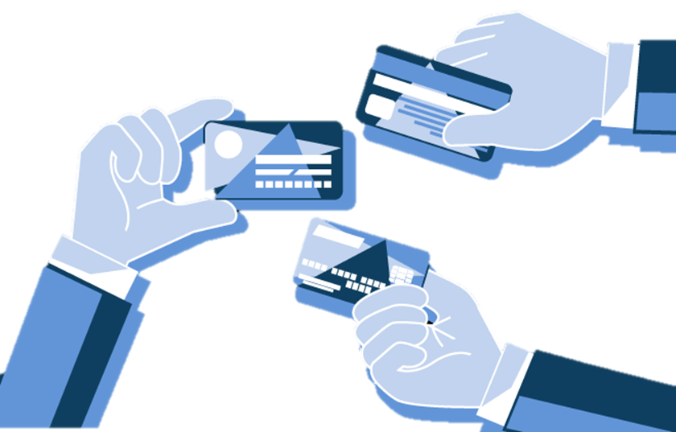
CREDIT CARDS
Easy line of credit
Can you pay for it in cash?
Can help increase your credit score!
Notes:
Credit cards are a quick way to get access to money. They can be very helpful but can also be dangerous. They allow you to purchase anything up to your limit on the card. A good rule of thumb for a credit card is only use it if you can write a check for that amount. Credit cards generally carry high interest rates, and if you only pay the minimum payment amount each month, it can take you years to pay them off. You do not want to run up a bunch of debt on your cards and not be able to pay it off, this will end up hurting your credit score badly.
Although credit cards can be dangerous they can also be beneficial to your credit score. If you have a good amount of open credit cards and are paying them all off each month and keeping the balance to a minimum, this can help your score. It will show that you can handle many different accounts and are able to pay them off each month

Slide 88
WHY IS DEBT MANAGEMENT SO IMPORTANT?
Maintaining financial stability
Benefits
Accelerated payoff
Improve Credit Score
Flexibility
Notes:
Managing your debt is important for your financial stability. It allows you to keep track of your finances and make your finances work for you.
Benefits of managing your debt include accelerated loan payoff, improving your credit score, and increasing your financial flexibility. Managing your debt will help you not only save time and money, but will generally improve your credit score as you maintain on-time payments. If you manage your debt, you will have more financial flexibility when unexpected debts arise.

Slide 89
DIY DEBT MANAGEMENT PLANS
Create a Reduction Spreadsheet
Some debt reducing methods include:
  Snowball Method
  Avalanche Method
Notes:
One way to effectively manage personal debt is to create a debt management plan. These plans require you to look at your current spending habits, budget, and liabilities/debt. Two common plans include the Snowball and Avalanche Methods.

Slide 90

METHODS OF MANAGING DEBT
Step 1: List all debts smallest to largest
Step 2: Pay on smallest debts first until paid out
Step 3: Once smallest debt is paid, apply money to next
Snowball Method
Notes:
List debts from smallest to largest, REGARDLESS of interest rate. Pay each minimum payment on all debts EXCEPT the smallest one.
Pay as much as possible towards the smallest debt until it’s paid off completely. Once that debt is gone, apply that payment to the next smallest debt on your list while still paying minimums on your other debts.
Keep applying payment to the next smallest debt, and repeat this method until all debts on your list are cleared.

Slide 91

METHODS OF MANAGING DEBT
List all debts by order of interest
Pay extra on debt with highest interest rate
Pay highest debt off and apply payment to next highest debt
Avalanche Method
Notes:
The Avalanche method is used to eliminate debt by organizing payments by interest rates. The goal is to minimize how much interest you pay, which may help pay off debts faster.
List debts by order of interest rate, starting with the highest rate down to the lowest rate
Make minimum payments on all debts, paying extra on the highest rate. You're reducing the amount owed at that high rate.
Once you pay off a loan, move to the next highest interest rate and continue this cycle until all debts are paid off

Slide 92
PERSONAL SAFETY
BE PROTECTIVE OVER YOUR FINANCES
Notes:
One of the most important topics in finance is personal safety. Be protective over your finances! Lets take a look at how to better protect your information on the internet and at how lenders protect your information.

Slide 93
THE FIRST STEPS TO KEEPING YOUR INFORMATION SAFE
Understand what kind of websites to stay away from
Complete updates regularly
Turn automatic updates on
Notes:
Technology is an amazing innovation that has eased many complicated processes. From being able to shop online from the comfort of your couch to banking right at your fingertips. Technology has many positives and has helped many people stay connected across the globe but with these positives comes some negatives. There are bad people out there looking to steal your personal information which is why it is important to be able to identify secure websites and how to better protect yourself from your information falling into the wrong hands.
Regularly updating your computer is crucial in helping to fight off viruses and other malware that may damage your computer. Windows regularly updates when you restart your computer so be sure to restart your computer at least once a week so your computer can be prepared to fight off hackers. The updates can be found in the control panel under system. To prevent from you having to manually update it you can set it to auto updates so your computer stays up to date.

Slide 94
VIRUS SOFTWARE
Fights malicious software
Blocks suspicious activity
Confirms the safety of your computer and software
Use Pop-up blocker
Notes:
In 2019 Malware attacks were ranked as the 4th ranking mobile security concern. One popular form of malware are the pop-ups that uses scare tactics saying your computer is infected when in reality it is not. Viruses are a type of software scammers use that can slow your computer and also result in data loss. More malicious viruses are capable of stealing your private information. Just as windows needs to be updated regularly so does your virus protection software. Virus protection software acts as a wall of defense for your computer. It is able to track malicious software and flag suspicious behavior. There are numerous antivirus software but it is up to you to decide which one best fits your needs. In order for the antivirus software to work properly it is important to keep it up to date and renewed. Another way to better protect your computer from viruses is to disable pop-ups. You can disable pop-ups easily through settings in your web browser. Blocking pop-ups lowers the risk of you accidentally clicking an ad that may make your computer more susceptible to a virus.

Slide 95
SIGNS OF A SECURE WEBSITE
Privacy Policy
CLEAR privacy policy
Contact Info
Easy to navigate
Password Management
DO NOT use the same password
Required
Vague policy
Social media listed
Trustworthy
1password software easily manages all passwords
Notes:
Many tasks can now be completed online through various websites. These websites sometimes require confidential information that in the hands of the wrong person, could do some damage. This is why it is important to understand what a safe website looks like. The 1st sign of a safe website is the presence of HTTPS. HTTPS in a URL eliminates the possibility of someone else capturing the data packets in transit. A green padlock can be seen before the URL making it visible that the site is safe.
When on a website they should provide a privacy policy that CLEARLY states how your data is collected and stored. A vague policy is as good as no policy so be sure that they clearly state their intent with the data as it is required by data privacy laws. A clearly stated privacy policy lets you know that the owner understands the laws and is taking to necessary steps to ensure your data does not end up in the wrong hands.
Contact information does not mean a site is necessarily safe but it seems more trustworthy. Typically safe websites have an easy to find contact page or contact information, Generally they also list social media accounts and return policies. Though this does not mean the site is necessarily secure it means you at least have someone to contact if something goes wrong.
Almost any account created online requires a password of some sort which can become very elaborate. Having numerous accounts it can become difficult to manage all the passwords. It may seem very tempting but using the same password across all platforms is strongly discouraged as hackers can have access to everything if they get their hands on that password. There is a software program that can be used to store your passwords in your own personal vault. You’ll only need to remember the password for the vault then there you can access your passwords for other sites.

Slide 96
BE WEARY OF SUSPICIOUS EMAILS
Phishing
DO NOT GIVE OUT YOUR PASSWORD
DO NOT click on links through emails that request payment information or password disclosure
Notes:
Scammers sometime use emails to try and get your personal information, this is called phishing. These emails may look like they’re from a bank or company that you know. These emails will usually say that they’ve noticed some suspicious activity, offer free stuff and request your password. DO NOT GIVE OUT YOUR PASSWORD! Avoid clicking on links through emails that request personal information. If in doubt of an email, contact the company directly. In order to protect yourself from these emails it is important to use security software on both your computer and mobile device. Also multi-factor authentication can prevent scammers from being able to access your account if they do get your login credentials. Individuals lost $57 million to phishing schemes in 1 year in the U.S

Slide 97

SENDING PERSONAL INFORMATION THROUGH EMAIL
Only send personal information over email when absolutely necessary
Encrypted messages
Notes:
There may be times when you need to send personal information over email but when you do it is important that you stay safe while doing so. One way to protect your personal information such as wire information, social security number. account numbers and etc is through encrypted messages. Encrypted emails essentially have a key that only the designated recipient can open and read. This prevents scammers from accessing private information in emails. Through your email provider you can turn on encrypted mail which will help protect your information from scammers.

Slide 98


HOW TO BETTER PROTECT YOUR INFORMATION
Multi-factor Authentication
User awareness
Connect to secure WIFI networks
Notes:
There are numerous ways in which to be bale to protect your privacy while using the internet. One effective measure is multi-factor authentication. Multi-factor authentication can be used when a computer user is requesting access to help ensure another level of protection. Before a user is granted access to an account they must sign in on another device such as your mobile device. This helps users ensure that they’re the only ones accessing their account. Another way to protect your mobile devices is through user awareness. Be aware of the permissions given to applications. Sometimes apps can access personal information if given the permission. Another way to stay safe is by being skeptical. When using WIFI make sure you are connecting to a secure network. Networks that do not require passwords should not be trusted and avoid using any banking apps while connected to these networks.

Slide 99


DISCARDING DEVICES
Dispose of them properly
Wipe devices before selling or discarding them
Notes:
When it comes time for a new upgrade remember to completely erase all information on your device. You may be selling your phone to your relative that you trust but they may sell it to someone else so it is best to make sure all your information is completely wiped off the device. Wiping your device ensures that your personal information does not fall into the wrong hands. Even if you feel like there is nothing important on the phone it is still important that you completely wipe all data from it. This can easily be done on your device as many devices have a factory reset option which completely erases all information from the phone. This option can be found in settings.

Slide 100
TOP FINANCIAL TIPS
Start investing & saving early for retirement
Consider advantages & disadvantages of different bank accounts
Create a budget to achieve your financial goals
Establish credit early, build your credit, & avoid hard credit hits
Get advice from a financial advisor or other financial professional/teacher
Cover risks with proper insurance
Always write down your goals & actively chase them down!!
Notes:
In conclusion, we’d like to offer our top financial tips. (Go over bullets listed above)

Slide 101
FARM CREDIT
WHAT WE DO
Notes:
So what is Farm Credit? Through this section, we’ll look at what Farm Credit does, the purpose it serves, and a little bit about our big passion for agriculture.

Slide 102
FARM CREDIT
The FC System
Member owned cooperative
Key elements in history
Woodrow Wilson: Federal Land Bank System
1916
Member-owned and member-controlled
1916: Long term lending
1930s: short-term and intermediate lending
100+ years of serving farmers
Notes:
Farm Credit Is a member-owned lending cooperative, created by Congress in 1916 to provide those in rural America with a dependable source of financing.
Based off of a cooperative model it is a member-owned and member-controlled business that distributes benefits to the basis of the use/user (patronage)
President Woodrow Wilson signed legislation creating the Federal Land Bank System in 1916 and since then we have evolved into 72 independent financial institutions. 1916 marked the time of long term lending abilities through Farm Credit, and in the 1930s farmers were able to have short or intermediate lending as well. Farm Credit has been serving farmers and rural America with reliable and dependable credit services for over 100 years.

Slide 103
THE FARM CREDIT LOGO
Leaves: types of lending
Roots: member-borrowers
Star: light and direction
Used within every associations logo
A reputation encompassing Farm Credit’s services and ongoing actions
Notes:
The BioStar is a symbol of progress and commitment consisting of five visual elements: three leaves, a root system, and a star. The leaves represent the three types of lending done by the Farm Credit System – long-term, intermediate-term, and short-term. The roots represent our member-borrowers, and the star represents light and direction. The BioStar is used in the national logo and many System entity logos. It is much more than a logo; it symbolizes the reputation FC has built over many years. It’s the sum of all the tangible and intangible characteristics that make Farm Credit unique, encompassing the services we deliver, the ways we connect with our members, the messages we communicate, and the look of our marketing materials (go over each bullet listed above)

Slide 104

WORKING AT FARM CREDIT
Team based collaborative atmosphere
Communication
Playing a role in agriculture
Face-to-face interaction with customers
Multiple career opportunities:
  Loan Officer
  Appraiser
  Credit Manager
  Loan Processor
  Branch Office Coordinator
  Human Resources
  Operations & Accounting
  And many more!
Working at Farm Credit allows the individuals to play a role in agriculture financially!
Notes:
Working at Farm Credit the employees are in a collaborative atmosphere where they have the opportunity to communicate and work with other employees as well as customers. With this atmosphere there is a lot of multitasking that goes on daily in the office.
As employees work in the office they are also involved with their customers outside of the office. This can include visiting a farm, home construction site, potential land properties, sponsorship events, livestock shows, etc. Our lenders work closely with customers to best meet their needs and create a relationship with them. If you’re interested in learning more about working for Farm Credit, head on over to the Careers page on our website.
(Go over the bullets listed on the slide)

Slide 105
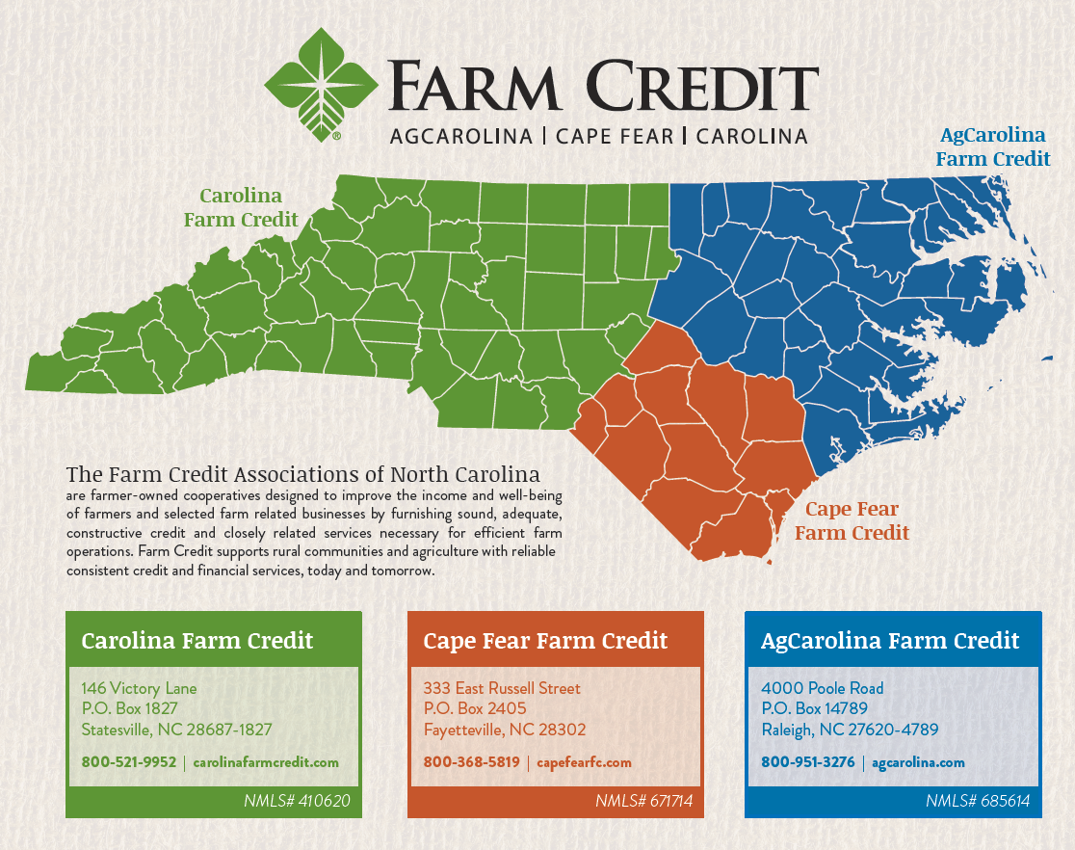
3 FARM CREDITS OF NORTH CAROLINA
AgCarolina, Cape Fear, & Carolina
Loans to rural residents across the state
$3.9 billion in loans to 17,650 customers
Source of credit for farmers & rural residents
Notes:
North Carolina farmers and rural residents can qualify for loans for farms, homes, agribusinesses and more from 1 of 3 Farm Credit Associations in North Carolina, with branch offices across the state. These 3 Associations include AgCarolina Farm Credit, Cape Fear Farm Credit, and Carolina Farm Credit. We're part of the national Farm Credit System, which has been serving the credit needs of rural America for over 100 years. With our long tradition, local know-how and agricultural expertise, we provide our members with a dependable source of credit generation after generation. More than $3.9 billion in loans are outstanding to more than 17,650 members who own our 3 cooperative Associations.
Our directors are also farmers, and they oversee our organization to protect the interests of our members at all times.

Slide 106
Thank you for joining us through this EXCITING PRESENTATION!
Visit our website farmcreditofnc.com

