Slide 1
Notes:
Welcome to the Personal Finance Workshop created by the Farm Credit Associations of NC. I am Amanda Smith, a credit analyst with Farm Credit in Greenville, NC. I look forward to sharing valuable information with you to help as you plan your finances for today and prepare for tomorrow. Let’s get started!

Slide 2
CREDIT & LOANS
SPEAKING THE LOAN LANGUAGE
Notes:
So far we’ve discussed saving and spending money. Now we’ll look at borrowing money when you don’t have enough to cash on hand to cover an expense. This will involve credit and loans.

Slide 3
UNDERSTANDING CREDIT
Credit Report – your history of loans, mortgages, tax liens, repayment history, etc. all listed on one report
Credit Score – a score showing your reputation as a borrower of money
A credit score is a number based on a level of analysis to represent the creditworthiness of an individual.
Notes:
A credit report shows how much debt you have and if you have paid off your bills on time. It shows all credit accounts you have including home mortgages, credit cards, equipment dealer loans, student loans, etc. It also lists if you’ve been late on any payments, if you have went through any bankruptcies, if you haven’t paid your federal/state taxes, and if you have any judgements.
The report also lists your credit score. A credit score is a calculated number that shows lenders how likely you are to repay your debts. It represents your reputation as a borrower of money.

Slide 4
UNDERSTANDING CREDIT
Will be used anytime you get a loan to:
Purchase a car
Take out a loan to pay for college
Buy a house
Buy an ATV
Buy land
Get a credit card
Something everyone has
Notes:
Your credit score is something everyone will have if they have ever borrowed money. It will be used anytime you get a loan to (read list above).

Slide 5
CREDIT SCORE RANGE
Notes:
Your credit score is calculated by three credit reporting agencies, Equifax, Experian, and TransUnion; these are all averaged out and come together for your final FICO score. FICO is the score that people look at most often to get the best idea about your credit history.

Slide 6
WHAT IS A CREDIT SCORE?
Where it comes from
Checking your credit score
Good credit vs. bad credit
800-850
300-579
740-799
580-669
670-739
Notes:
You are allowed one free credit report from each of those credit reporting agencies once every twelve months. It is important to occasionally check your credit report to make sure there are no fraudulent charges and that your identity has not been stolen. It is also important to maintain a good credit score. A credit score can range from 300-850, you want your score to be as high as possible. Typically a good score is above 700. A score above 800 is exceptional, not many people will get over 800.

Slide 7
WHAT AFFECTS YOUR CREDIT SCORE?
Notes:
Many things can affect your credit score, such as your payment history which accounts for 35% of your score; this shows how well and timely you pay off your balances on credit cards and any other debts you have that need to be paid. Outstanding Credit/limit, which is 30% of your score; this shows how much you are allowed to use compared to how much you actually use. Normally you want to keep this around 10% for each Credit Card, if you go above this and leave the balance high on it from month to month this can hurt your score. Length of relationship, this is 15% of your score and shows how long you have had credit, the longer you have a good history the more it will help your score. If you can show that over time you can consistently pay off debt your score will be higher. Types of credit is 10% of your score, this talks about what kind of credit you are using. This means having a diversity of credit types, like a car loan, credit card, student loan, mortgage and more. Showing that you can pay off a wide variety of loans can really help boost your score. New credit finishes the score off at the last 10%, this shows how many new credit accounts you have opened in the last 12 months. This also takes into consideration each time someone is pulling your credit report. If it shows that your report has been pulled a lot in the past year, this can indicate a greater risk. It can hurt your score to pull a credit report a lot and show that you are trying to get money from a lot of different sources.

Slide 8
BENEFITS OF HAVING A GOOD CREDIT SCORE
Loan Approval
Saving money
Interest rates
Eligible for lower auto and homeowner insurance premiums
Notes:
There are a bunch of benefits to having a good credit score, one being that it is easier to get accepted for a loan. With a high score it shows lenders that you have been responsible with the money lent to you and that you have paid it back on time. Another big benefit that will save you a lot of money is you will be given lower interest rates on loans you receive. This will save you money in the long run by not having to pay a high interest rate. You will also be eligible for lower auto and homeowner insurance premiums. These are both generally expensive but with a good credit score, you will be able to save thousands of dollars each year. It can also eliminate the requirement of paying a deposit when signing up for utilities like power.

Slide 9
TOP 3 C’S OF CREDIT
CAPACITY
Can you repay the money that is lent to you?
What income do you have?
CHARACTER
Have you been a good customer at other banks?
Do you have good repayment history?
COLLATERAL
What can we hold to get you to repay?
Lien = statement of ownership rights on a piece of collateral
Notes:
In addition to your credit score, lenders often look at some top Cs of credit including Capacity, Character, and Collateral. (Go over each bullet and sub-bullet)

Slide 10
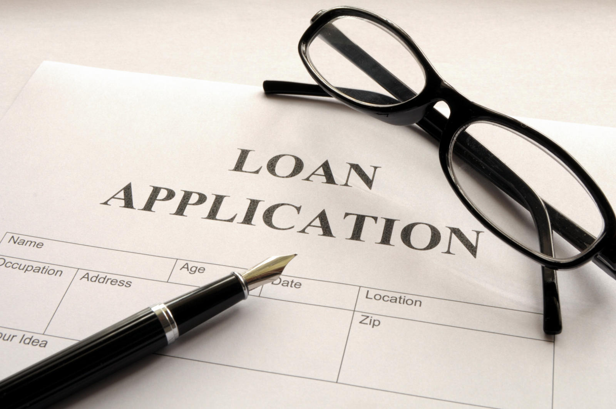
WHAT IS A LOAN?
A form of debt
Money borrowed from a lender, with a promise to repay the money + interest
Lenders
Bank
Credit Union
Farm Credit
Notes:
Now that we’ve covered credit and talked about the things listed on your credit report, you may be wondering What is a Loan?
Loans are a form of debt incurred by an individual or entity referred to as a borrower. A borrower borrows a sum of money as an advancement, and in return repays the lender the advancement with additional charges, interest, fees, or other conditions applicable. Loans may be for a specific, one-time amount, or as an open ended line of credit, with a specific limit.
Loans occur when a sum of money or credit is borrowed from lending institutions, such as:
banks, credit unions, or Farm Credit, and is expected to be paid back usually with additional interest.

Slide 11
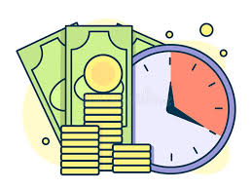
SPEAKING THE LOAN LANGUAGE
Borrower
Lender
Collateral
Interest
Annual Percentage Rate
Notes:
Let’s go over some basic loan terminology commonly used when regarding loans
A borrower is a person or entity that attains finances from another individual or business, for a specific amount of time with the condition to pay it back
A lender is an individual, entity, of financial institute that makes money available to another person or business with the expectation of repayment. Repayments will include interest and fees
Collateral is an asset a lender accepts as security for a loan. In the event that a loan cannot be repaid by a borrower, collateral is used as a form of payment, as well as an incentive for borrowers to repay their debts.
Interest is the charge or cost of borrowing money, and is usually expressed by an annual percentage rate (APR).
The term APR refers to the rate of interest charged to borrowers and paid to lenders.

Slide 12
SPEAKING THE LOAN LANGUAGE
LOAN AMOUNT
Larger loan amount = larger monthly payment
DOWN PAYMENT
15-25% for land
5+% on average for homes
FEES
Charges in addition to the purchase price of the things you buy
Cover costs that the lender has in providing money to you for your purchases
TERM
Length of time you have to repay the loan
Longer term = lower monthly payment BUT larger total interest charges over the full life of the loan
INTEREST RATE
Percentage amount added onto each payment
Higher rate = greater total interest charge over the full life of the loan
Notes:
(Go through each bullet)
Loan amount – total amount of money borrowed
Down payment – any cash you pay towards the purchase in addition to the amount of the loan. Sometimes a down payment is required because the lender will only lend you part of the total purchase amount. (give the land loan example listed)
Fees – (give description listed)
Term - (give description listed)
Interest rate – the lender’s cost to you for allowing you to borrower their money. (give examples above)

Slide 13
INTEREST RATES
Interest rates are the amount a lender charges for the use of borrowing money or assets
Fixed Rates
Variable Rates
Adjustable Rate
Notes:
Lenders offer a variety of fixed, variable, and adjustable rates, depending on the type of loan a customer has.
A fixed interest rate is an interest rate that stays the same over the span of a loan,
or for a portion depending on the AGREED ARRANGMENT
Variable-rate loans have an interest rate that can vary up or down, during the term of A loan. The rate being charged on variable rate loans is tied with a particular “index”. These indexes allow you, the borrower, to judge for yourself, what potential movement there may be in the rate.
Adjustable Rate Mortgages (ARMs) are a special kind of product, that combines features of both fixed and variable interest rate products. ADJUSTABLE RATE MORTGAGES OR ARM’s,
fix the interest rate for a specific period of time-- one-year, three-year or five-year. The interest rate is indexed to US Treasury securities. As US Treasury rates move, the rate on the ARM may ALSO MOVE, after the initial fixed period.
When obtaining a loan it is important to ask whether there are an pre-payment penalties for the loan. A pre-payment penalty is an additional fee that some lenders charge you for paying off your loan early.

Slide 14
INTEREST
Interest
A percentage of a loan to be paid to the lender for the privilege of borrowing money.
Simple Interest
Interest on the principal amount borrowed.
Compound Interest
Interest on the principal and interest accrued on the amount borrowed.
Activity 6
Notes:
There are three different types of interest: (give examples and definitions above)

Slide 15
LOAN TYPES
Secured
Unsecured
Commercial
Agri-Consumer loans
Notes:
Now let’s discuss some of the different loan forms that you’ll commonly see when obtaining a loan:
Secured loans require an asset’s collateral for the loan. This collateral is used as a payment to a lender should the loan be unpaid by the borrower. This usually results in lower interest rates for the borrower. Some common examples of secured loans are mortgage, vehicle, and secured credit cards etc.
Unsecured loans have NO collateral, just an agreement to repay the loan. Unsecured loans are issued based on the borrower’s creditworthiness. For this reason, unsecured loans may have higher interest rates, as well as additional fees to pay. Some examples of unsecured loans are credit cards, student loans, and other personal lines of credit.
Commercial loans are financing arrangements between a business and financial institution. Commercial loans are usually used to purchase major capital and cover operational costs. Companies generally provide financial statements to prove their repayment ability.
Agri-Consumer loans are smaller farm loans directed specifically to farmers and other agriculture expenditures. AGRI-Consumer loans enable farmers to secure equipment, plant, harvest, marketing, and otherwise diversify their farms or agriculture ventures.
Before applying for any loan, carefully evaluate your personal finances. Loan terms are agreed upon by all parties involved before money is advanced.

Slide 16
FARM LOANS
Equipment
Operating & Livestock
Farm Improvements
Notes:
Farm Credit offers an array of loans that support farm, land, and home financing.
FARM LOANS at Farm Credit may be used for equipment, operating & livestock, and farm improvements.
Equipment loans offered at FARM CREDIT may be termed up to 5-7 years. Equipment loans may be applied to items such as horse trailers, tractors, ag trucks etc.
Livestock loans offered at Farm Credit may be termed up to 4 years depending on the animal. Some cattle and livestock THAT MAY be financed include cows, goats, poultry, horses, etc.
For borrowers interested in farm improvements, Farm Credit offers the option of a short term (up to 7 years), or long term (up to 15years) loan. Farm improvement loans may be used for upgrading buildings and structures intended for agriculture, and other maintenance expenses.

Slide 17
LAND LOANS
Acreage
Farm Land
Country Homes
Notes:
As a farmer or rancher, whether you are just starting out or have many years of experience, there are times when you need to borrow money to start, expand, sustain, or make changes to your business.
Farm Credit offers loans to help build your dream home, growing space, or operational expansion.
Land loans at Farm Credit can be categorized by farming and building intent. Borrowers seeking land financing with a farming intent have term loan term options of 1-20 years. Land loans with a building intent share a similar lending total with shorter term lengths. Building intent loans may be termed up to 10 years.

Slide 18
HOME LOANS
No max acreage limitation
Competitively Priced
No max loan amount
Government Loan Flexibility
Manufactured housing eligible
Notes:
Farm Credit understands that the process of purchasing or building a new home can often be overwhelming. Specialists at Farm Credit help buyers to understand the home buying process, and offer a wide selection of purchasing options. Farm Credit services purchasing, building, and refinancing homes. Home loans may be financed up to 30 years. We offer a one-time closing for home construction loans, as well as a locked in interest rate. These features help the borrower save money on closing and some building costs.

Slide 19
IMPORTANT LOAN REMINDERS
Make your monthly payment
If you are able, make higher payments towards the principal amount to reduce the amount of interest that would accumulate.
Reduces the overall cost of the loan
Notes:
Loans can be a tricky but very useful tool during your lifetime. The most important things to remember are: (Go over information above)

Slide 20
CREDIT & LOANS – Review Questions
What are the credit score ranges? What is considered a good credit score?
What is the advantage of making higher monthly payments?
What is the difference between simple and compound interest?
For a savings account, would you want your interest compounded more or less often?

Slide 21
Thank you for joining us through this EXCITING PRESENTATION! Visit our website farmcreditofnc.com Contact us at: 800-521-9952
Notes:
As you can tell, providing personal finance education for students is important to Farm Credit. Today’s presentation is part of an eight-part series, so I encourage you to explore the other topics. To contact us, feel free to visit www.farmcreditofnc.com. Thank you for joining me!

